Slide 1
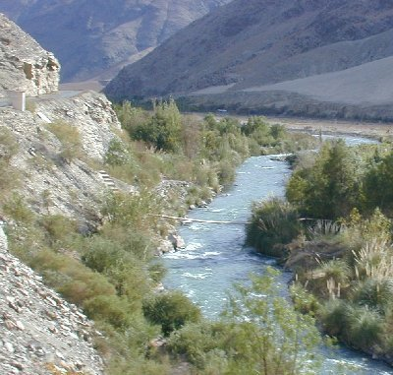
Near term climate change projections
for vulnerable catchments
Koen Verbist
International Hydrological Programme (IHP)
UNESCO

Slide 2
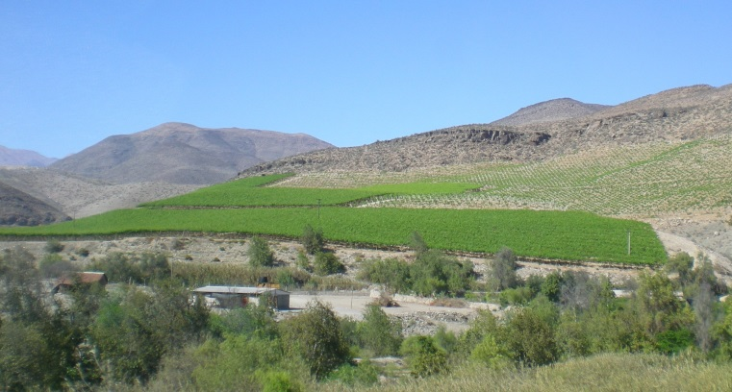
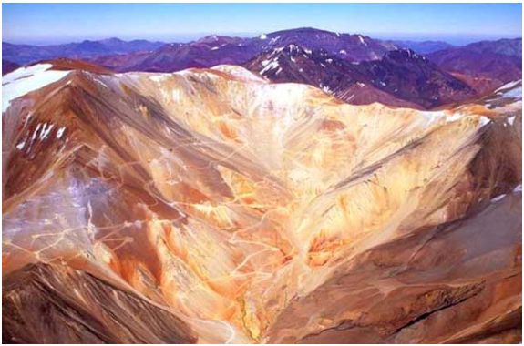
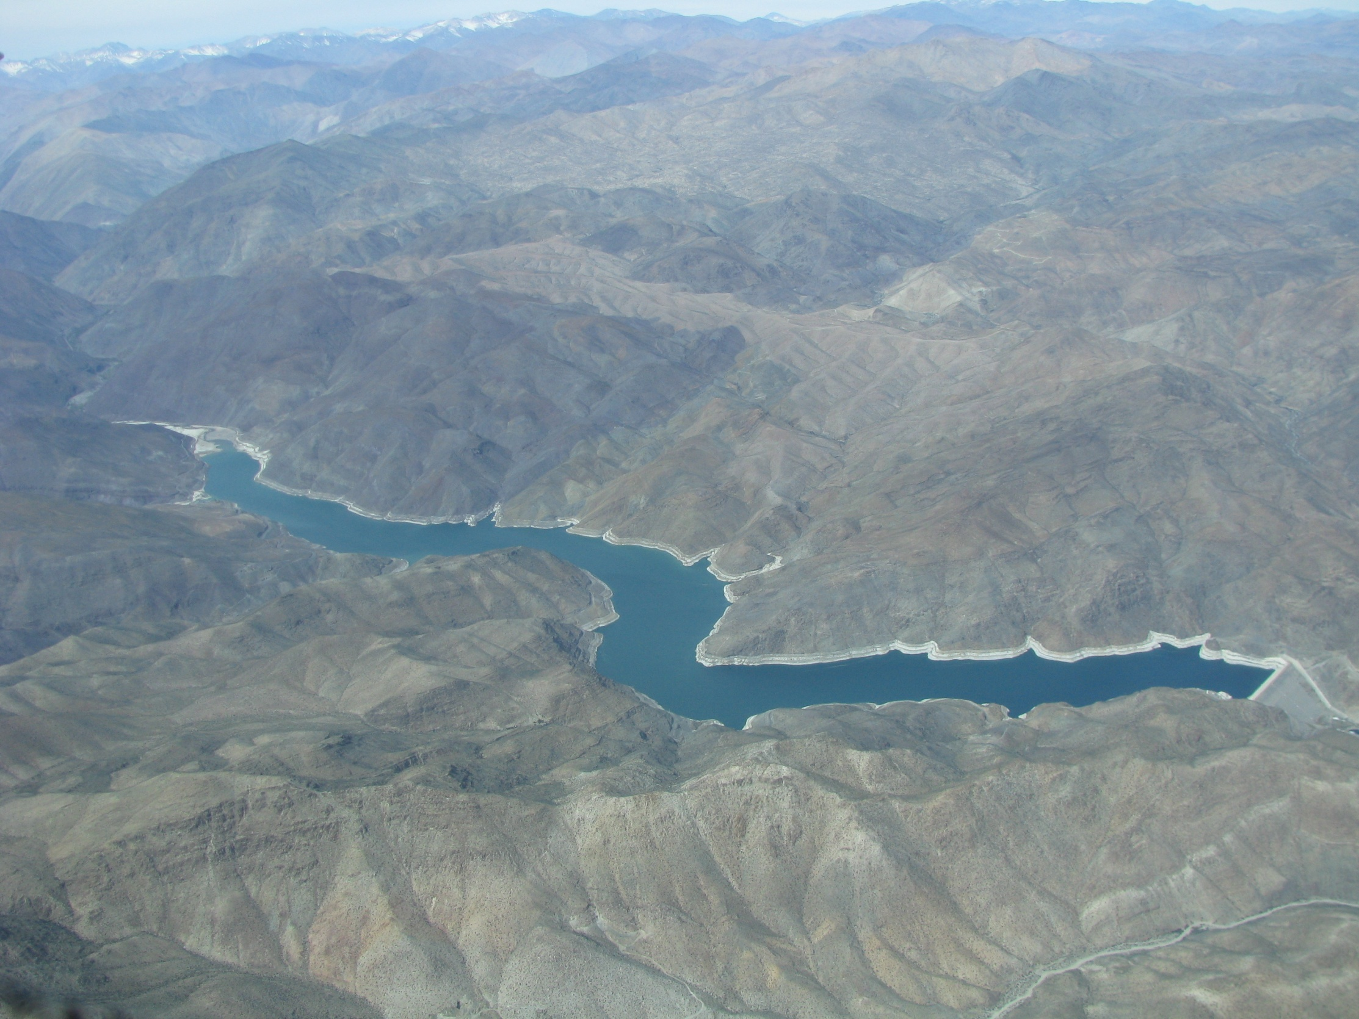
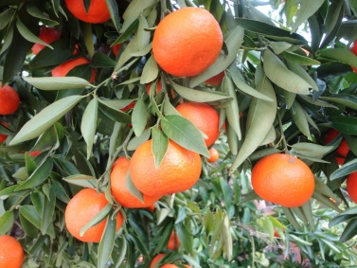
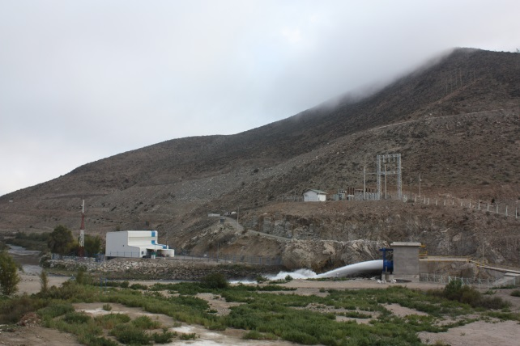
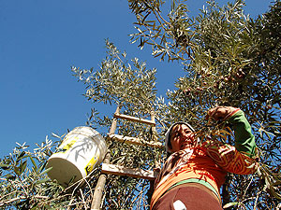
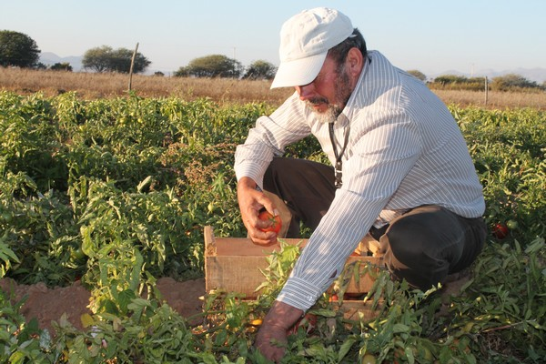
Evaluating Water Security in pilot watersheds in Latin America
Vinyards
Mining
Are current operation rules of
multipurpose water reservoirs sustainable?
Citrus
Hidroelectricity
Olives
Traditional
Agriculture
Notes:
We present here a methodology, not for predicting the future hydroclimate, but for the characterization of future climate uncertainty over the next few decades.
2

Slide 3
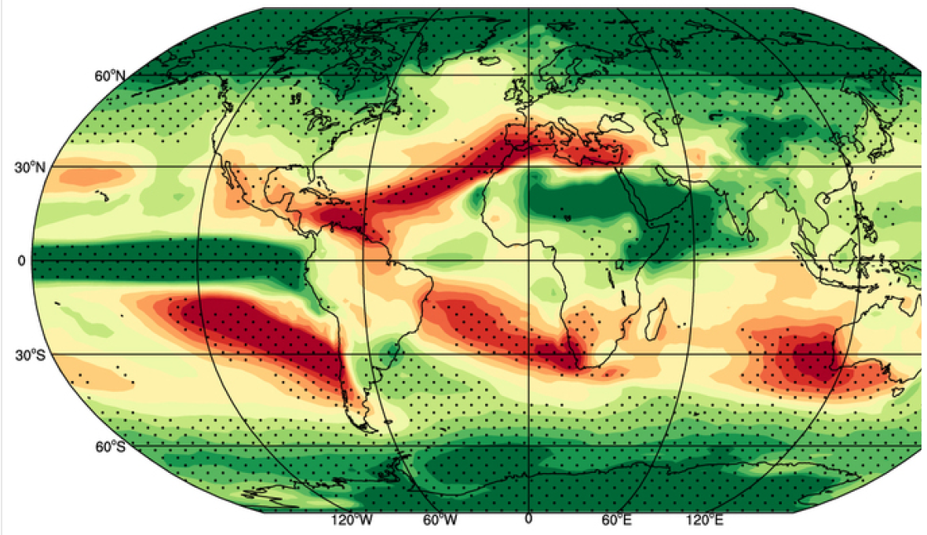
There is a need to translate Global Circulation Models to the local level
Average projected precipitation using the CMIP5 models
Projected values for 2060–2089 with respect to 1960–1989,
using the RCP8.5 scenario.
Polade et al.,
Nature, 2014
Questions relevant at the watershed level
Can the watershed provide suficient water resources under future scenarios?
Is there an expected increase in the frequency of droughts?

Slide 4
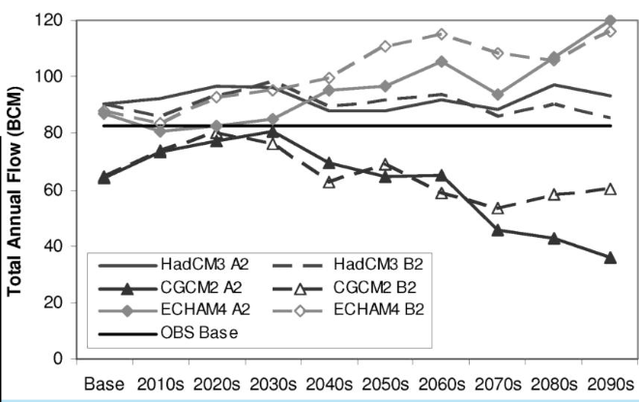
Why can’t we just use GCMs for projections ?
6 GCM projections for Total Annual Flow in the Nile Basin
Decision Making?
DiBaldassare, 2012
Entire modelling chain (climate modelling, spatial and temporal downscaling, hydrological modelling, and impact assessment) is affected by large uncertainty

Slide 5
Natural variability is not well captured by GCMs
TREND
DECADAL
INTER-ANNUAL
SUB-ANNUAL
Better to use the historical record for decadal/interannual variation

Slide 6
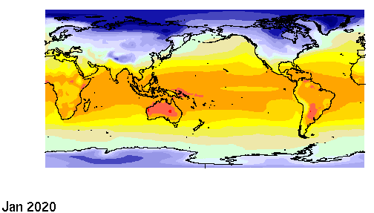
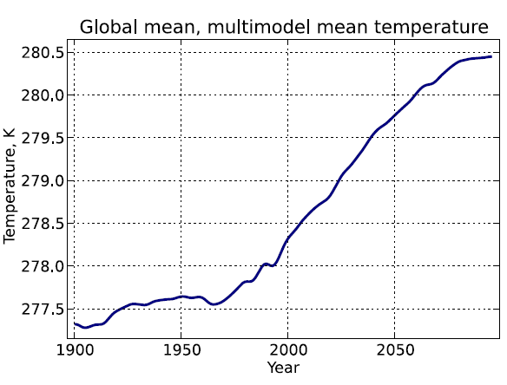
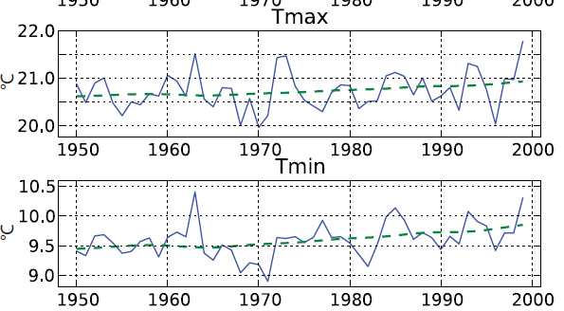
Use GCMs only to express the trend of future climate
Parameterize trend in terms of climate sensitivity.
Notes:
Since we associate trend with anthropogenic climate change, which takes the form of global warming, we model it in terms of regional sensitivity to global temperature change:
In the absence of anthropogenic forcing the globe does not warm, and future trends are null. The globe is not expected to warm uniformly; some regions will warm more rapidly, others less so, than the global mean. Fitting local trends based on global climate sensitivity takes this variation into account.

Slide 7
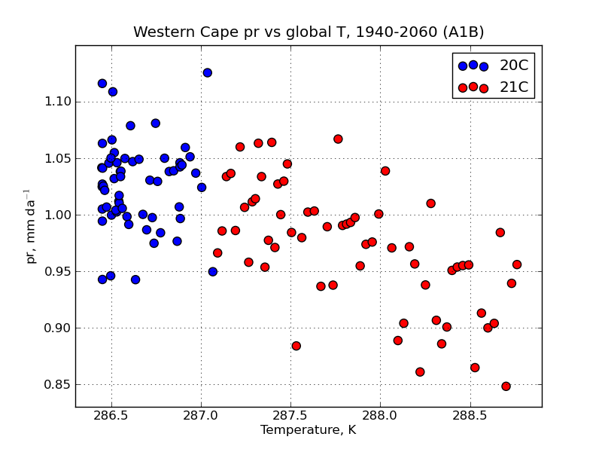
Use GCMs only to express the trend of future climate
Climate change trends: Precipitation
Precipitation Trend in terms of temperature sensitivity
In EACH GCM
Precipitation Trend distribution
for ALL GCMs

Slide 8
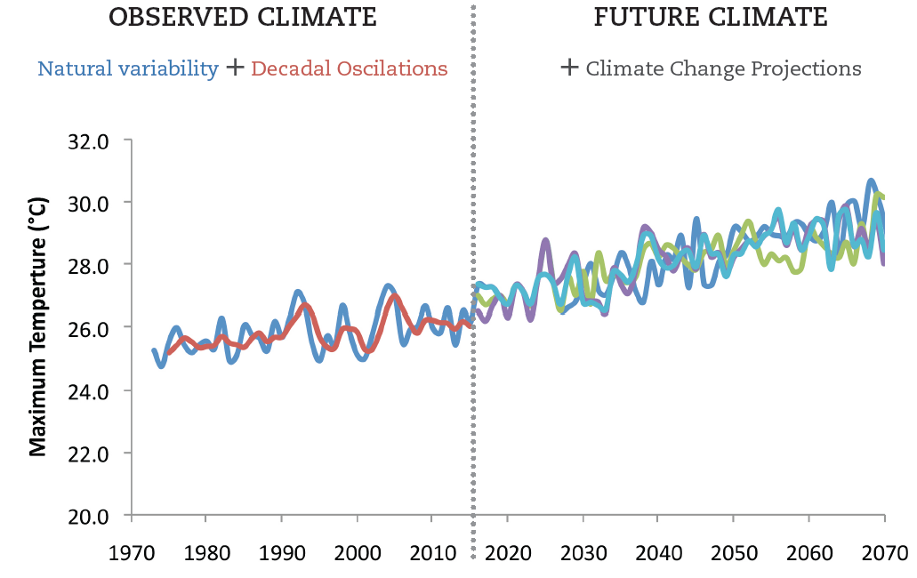
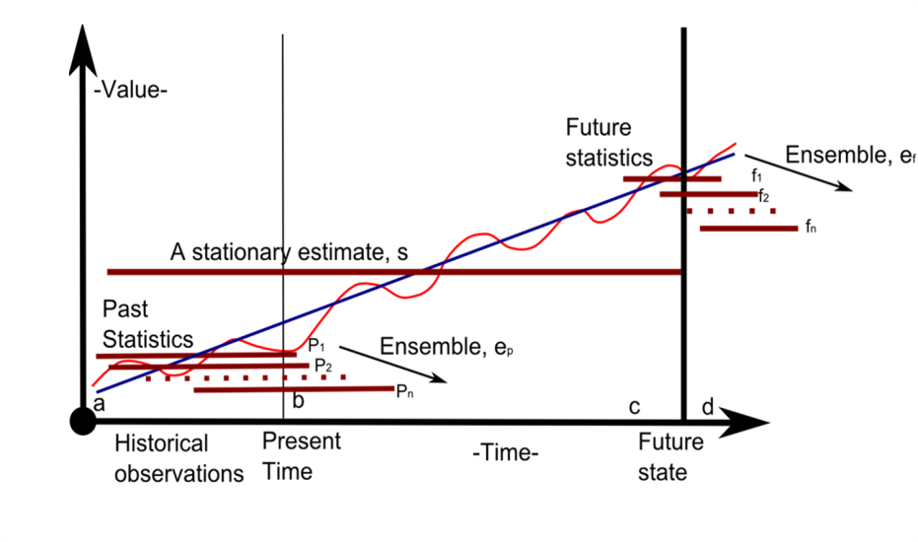
Generation of stochastic sequences of climate projections
No ‘prediction of the future’ but a characterization of future climatic uncertainty over the next few decades
Notes:
We present here a methodology, not for predicting the future hydroclimate, but for the characterization of future climate uncertainty over the next few decades.
8

Slide 9
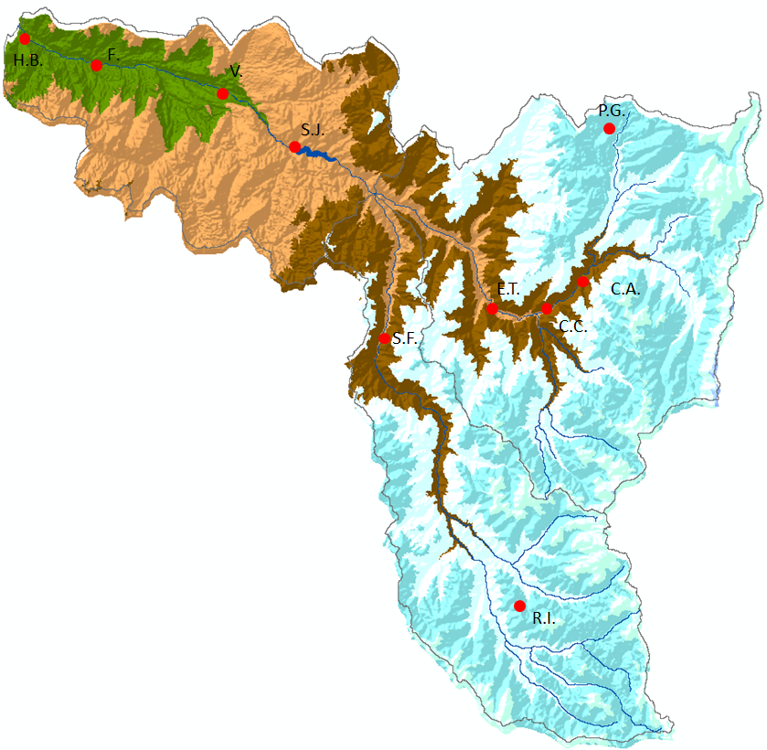
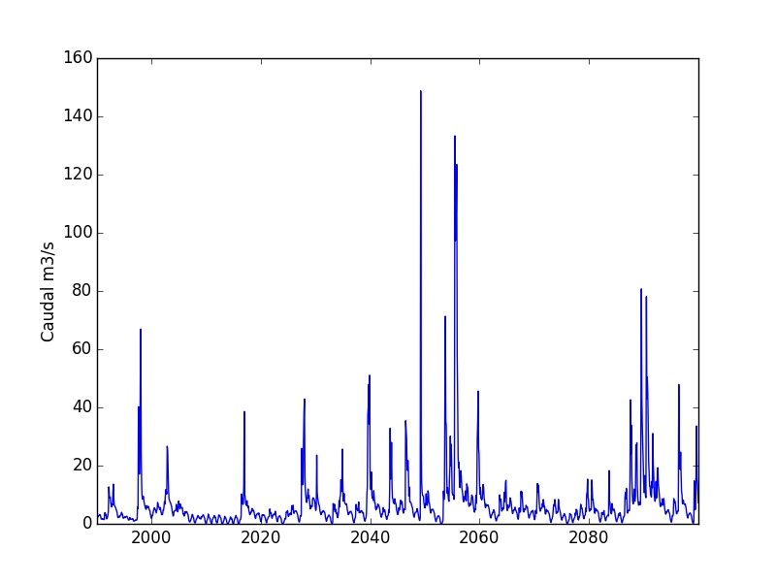
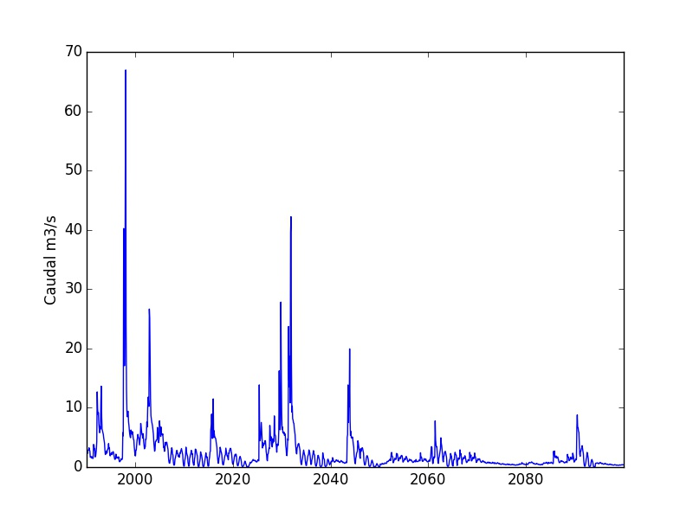
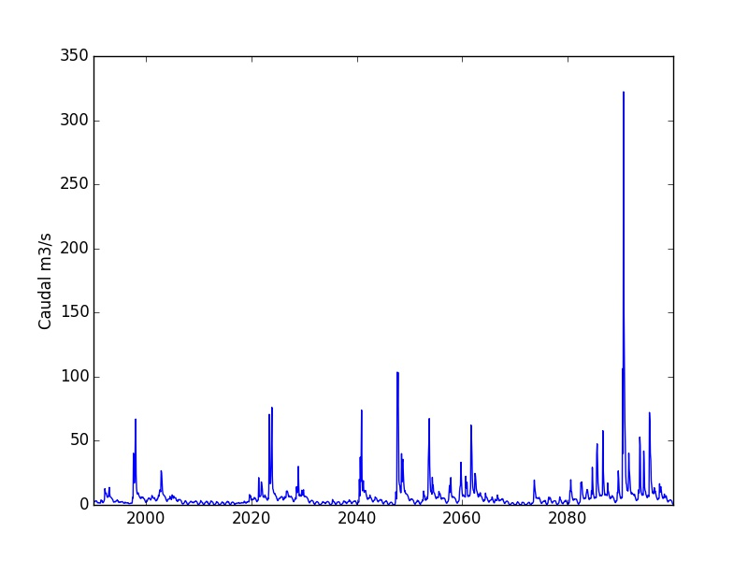
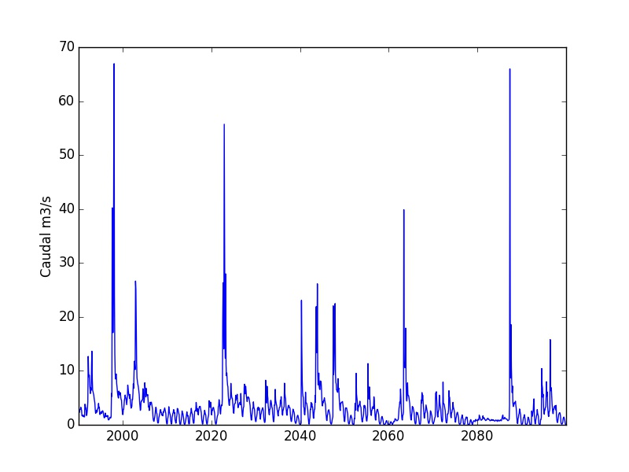
Application to reservoir management models (WEAP)
Characterization of future climatic uncertainty over the next few decades at the watershed level, relevant for decision making.
Notes:
We present here a methodology, not for predicting the future hydroclimate, but for the characterization of future climate uncertainty over the next few decades.
9

Slide 10
Pilot cases in Chile, Peru, Bolivia, Argentina, Colombia, Costa Rica and Honduras
Workshop in Cartagena, August 2015
Selected Pilot Watersheds:
Peru - Cuenca Chancay
Bolivia - Cuenca del rio Keto
Bolivia - Cuenca del Rio Desaguadero Medio
Colombia - Cuenca del Río Bogotá
Costa Rica - Cuenca del Río Toro
Honduras - Cuenca del Río Choluteca
Argentina - Cuenca del Aroyo Itacaruaré
Chile – Cuenca del Río Huasco
Notes:
We present here a methodology, not for predicting the future hydroclimate, but for the characterization of future climate uncertainty over the next few decades.
10

Slide 11
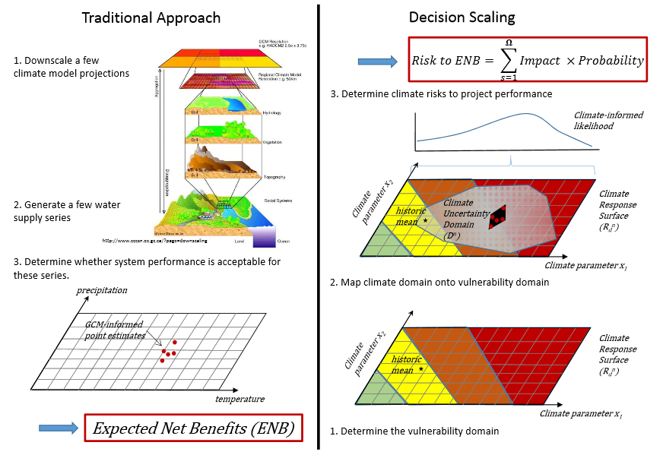
Synergies with the CRIDA approach
Top Down versus ‘Decision Scaling’ / CRIDA
SIMGEN

Slide 12
Near term climate change projections
for vulnerable catchments
Towards a Climate Risk Informed Decision Analysis
Koen Verbist
International Hydrological Programme (IHP)
UNESCO

