Slide 2
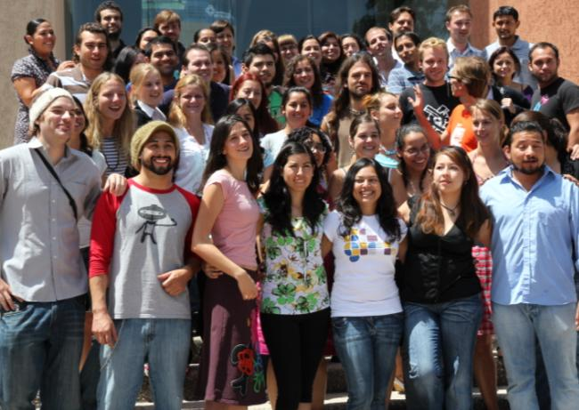
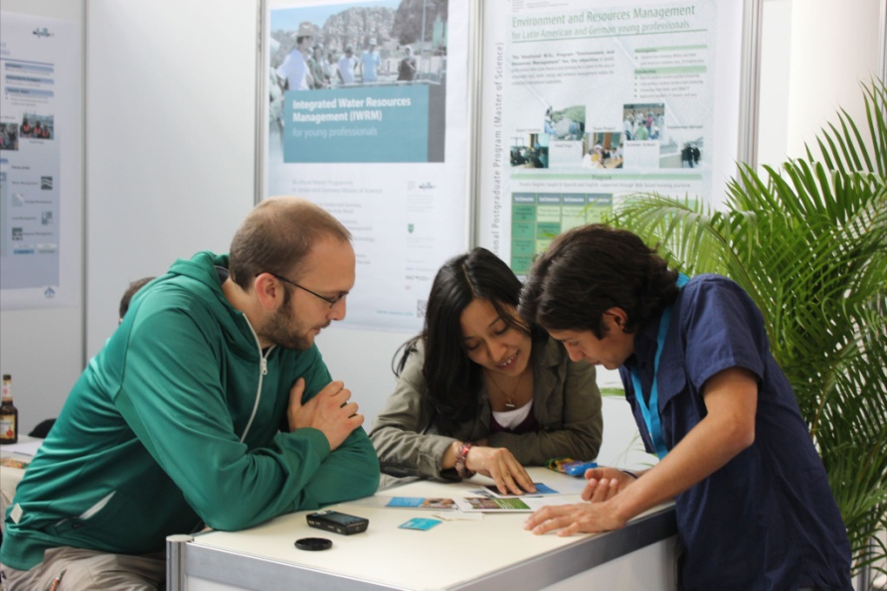
About ITT
Key Services:
Education (MSc PhD)
Research,
Capacity Development
Focus:
Managing Natural Resources (Land, Water, Energy)
Regional Resources Management (global and local links)
Main work in Africa, Asia, Latin America
Facts and Figures:
ITT is a central academic unit of CUAS
Staff: total 70 (6 professors, 30 scientifc, 35 support)
Students: 200 Msc and 35 PhD / 46 Nations

Slide 3
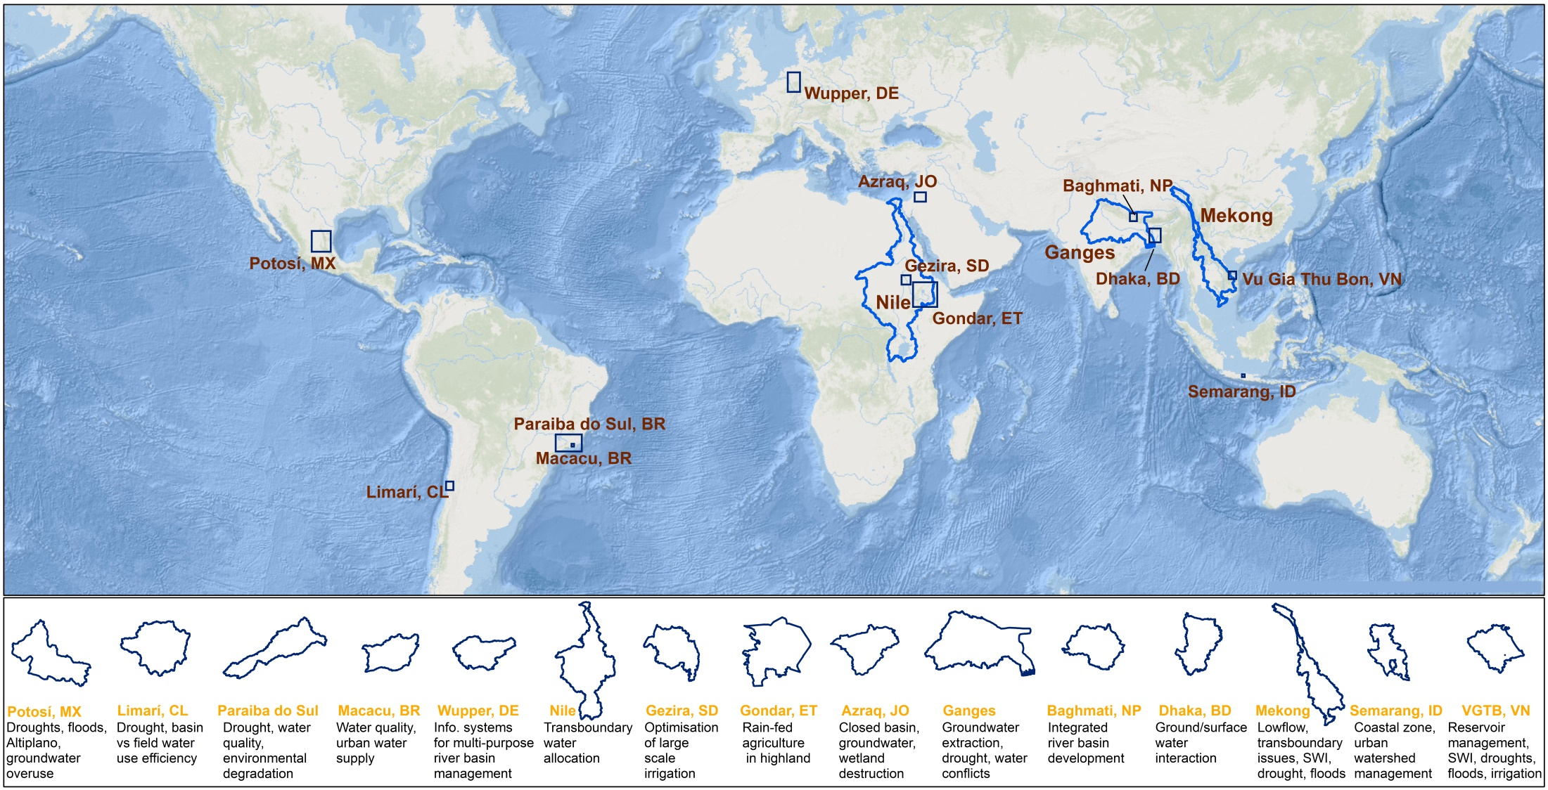
Current case studies of ITT partner network solution oriented research together with local research parterns and stakeholders
Tarcoles, CR
Magdalena, CO
Paute, EC
Jaguaribe, BR

Slide 4
Current Proposals
ERANET-Lac, IKI (BMU), H2020
GROW BMBF

Slide 5
Current Proposals
ERANET-Lac, IKI (BMU), H2020
GROW BMBF

Slide 6
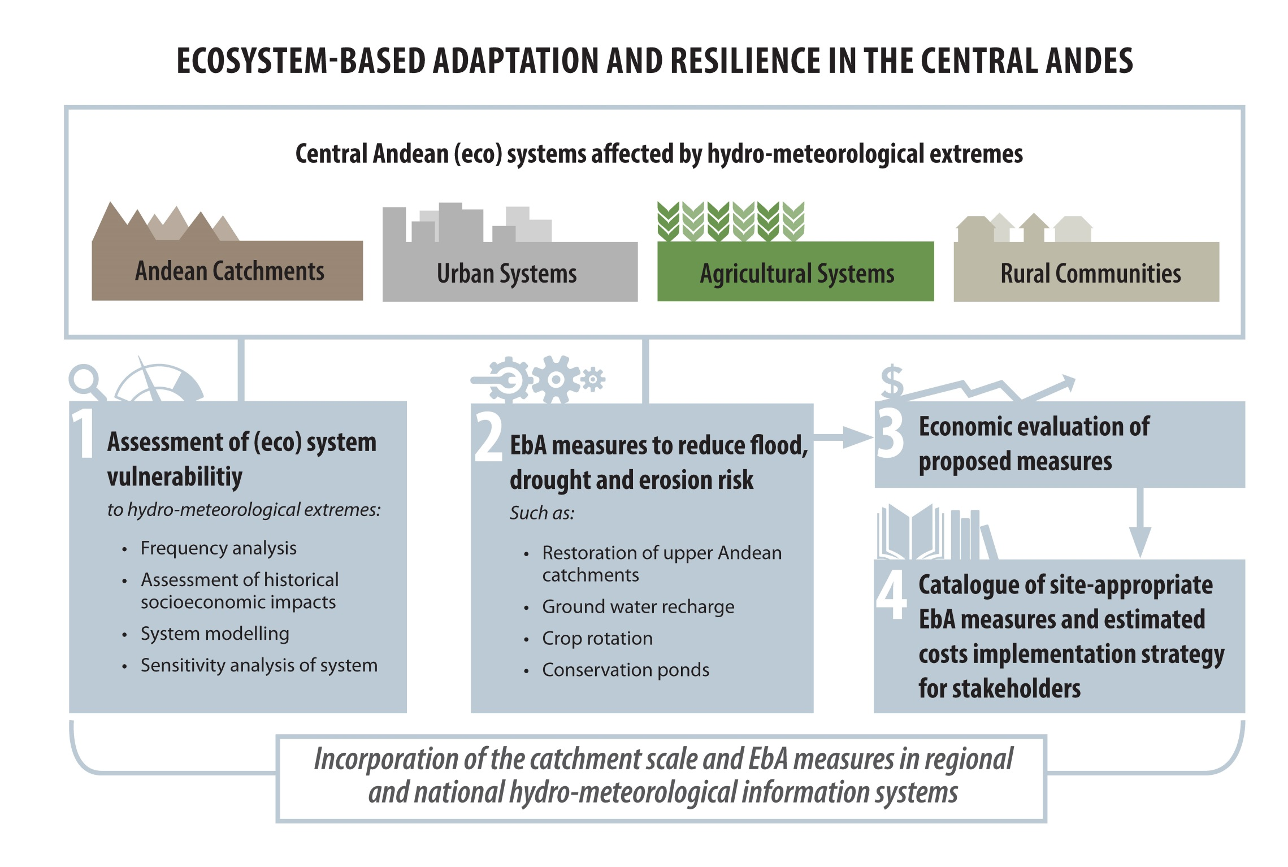

Slide 7
Water Security Toolbox -development, application, capacity development-
Water Security Toolbox
Data links
Algorithms
Methods
Models
BMPs
..
Remote sensing:
eg. PERSIANN, LAC/Afcian Drough Monitor, LandCover, ET, Reservoir/lake level, gw …
Decision Making
Water Accounting
SDG 6.4; 11.5
Water availability
Water uses per sector /per land use
Water use efficiency and productivity
Drought assessment + warning
Scenario development
In-situ data: P, Q, gw level, community based
Spatial scales: (sub-) basin, irrigation scheme
Temp. scales: d, m, a
customized maps + figures
Activities (BMBF, EU Water JPI 2016)
Develop Toolbox together with stakeholders and national research teams
Apply to pilot basins
Capacitate staff (national/basin agencies)
Upsaling, outscaling, knowledge sharing
We search for: partners for co-design and implementation of Toolbox
We offer: technical development of Toolbox, research support, training material,

Slide 8
Gracias!
Danke
Institute for Technology and Resources Management
ITT
in the Tropics and Subtropics
For more Information log on to:
www.basin-info.net/limari
www.hidro-limari.info
www.itt.fh-koeln.de

