Slide 1
Developing the Drought Vulnerability Map of Chile
Koen Verbist and Froukje Kuijk
Hydrological Systems and Water Scarcity Section
International Hydrological Programme (IHP)
UNESCO

Slide 2
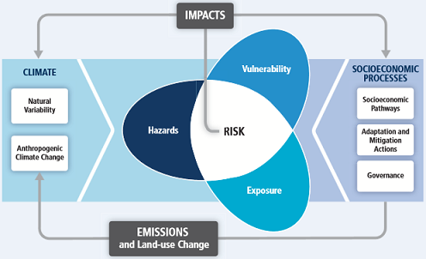
Vulnerability in its context
Summary for Policymakers (IPCC, 2014)

Slide 3
Two perspectives on Vulnerability assessment
Methodological Approach Considering Different Factors Influencing Vulnerability - Pan-European Scale(De Stefano et al., 2015)
 | Disaster Risk Reduction | Climate Change Adaptation
Goal | To highlight means for risk reduction of shocks | To find the most efficient way to adapt to CC
Vulnerability Assessment | It is considered as a step/part of a risk assessment process, together with hazard exposure evaluation | It is considered as the expected outcome of the process
Responses to | Emergencies | Gradual incremental changes
Risk | Probability of loss. The threat (not only climate related) posed by natural hazards to vulnerable societies | The threat posed by CC (frequently refer as impacts)
Hazard | Primarily perceived as an external factor. Natural and man-made hazards | Usually incorporated within vulnerability, as exposure. Climate hazard
Exposure | Exposed assets; elements at risk (people, infrastructure, goods, economic activities etc.). | Relate to the magnitude and frequency of potential hazard. It is a component of Vulnerability
Sensitivity | Susceptibility or fragility. Sometimes it is equated to vulnerability | Sensitivity
Capacities | Encompasses coping and adaptive capacities. Also might include resilience | Mainly refers to adaptive capacity
Notes:
Exposure as the characteristics of the hazards (e.g. drought) vs.
Exposure comprising all the assets exposed, to the effects of a hazard; as a function of the geographic location of the elements.

Slide 4
Case Study Mexico (PRONACOSE)
Programa Nacional Contra la Sequía
(PRONACOSE)
Representative indicators clustered in Grade of Exposure (Ge), Sensitivity (S) and Adaptation Capacity (Ca)
Economic Vulnerability
Social Vulnerability
Environmental Vulnerability
Global Vulnerability

Slide 5
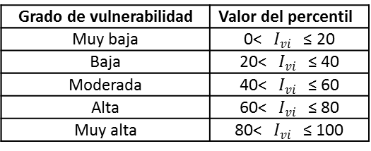
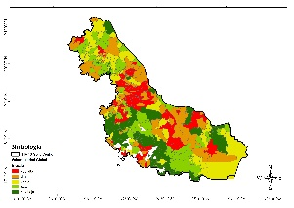
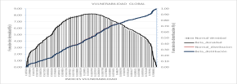
Proposed methodology (IMTA, 2015)
PASO 1
PASO 2
PASO 3
PASO 4
PASO 5
Zona de estudio
Identificar indicadores
(IPCC, 2007)
Recopilar
información
Análisis y procesamiento de la información
Determinación del peso de los indicadores
Continúa
Vulnerabilidad
Consejo de Cuenca
Grado de exposición
Sensibilidad
Capacidad de adaptación
Fuentes
Iyengar & Sudarshan (1982)
Min spatial unit:
catchment
>>
municipality
Operaciones y cálculo
Densidad de población (hab/km²)
Población económicamente activa desocupada (%)
Población sin derechohabiencia a servicios de salud (% )
Población en condiciones de pobreza (%)
Población analfabeta (%)
Grado de explotación de los acuíferos (adim.)
Grado de explotación de las cuencas (adim.)
Valor prod. agrícola ($)
Valor de la prod. ganado en pie ($)
Viviendas sin drenaje ni excusado (%)
Viviendas sin energía eléctrica (%)
Viviendas sin agua entubada (%)
Viviendas con piso de tierra (%)
Deforestación (ha)
Superficie afectada por incendios forestales (ha)
Superficie rehabilitada para riego (ha)
Superficie agrícola tecnificada (ha)
Longitud de caminos rurales (km)
Ingreso per cápita anual
Beneficiarios del programa Oportunidades
Beneficiarios del programa Liconsa
Años promedio de escolaridad
Superficie reforestada (ha)
Áreas nat. Protegidas (%)
CONAGUA
SAGARPA
CONAFOR
SEGOB
SHCP
SE
SS
SEDESOL
SEMARNAT
SENER
SEP
SCT
INEGI
CONAPO
CONEVAL
Preparación, manejo
Normalizar los indicadores [0,1], y sistematizar la información, bajo una relación funcional:
Si el factor aumenta la vulnerabilidad (↑):
Si el factor disminuye la vulnerabilidad (↓):
$$P_{j}=\frac{1}{\left(σ_{j}\right)\left(\sum_{j=1}^{n}{\left(\frac{1}{σ_{j}}\right)}\right)}$$
“Superdecisions” software (AHP)
>>
Iyengar & Sudarshan (1982) methodology
Donde: $P_{j}$, es el peso del factor j;
$$σ_{j},$$
$$x_{ij}=\frac{X_{ij}−X_{mín}}{X_{máx}−X_{mín}}$$
es la desviación
estándar de la matriz del factor j;
$$\sum_{j=1}^{n}{\left(\frac{1}{σ_{j}}\right),}$$
es la suma inversa de
las desviaciones de todos los indicadores j que participan.
$$x_{ij}=\frac{X_{máx}−X_{ij}}{X_{máx}−X_{mín}}$$
Donde: $x_{ij}, valor normalizado del$
$$municipio i, factor j;$$
$X_{ij}$, valor no normalizado;
$X_{máx}$, valor máximo de la matriz del factor j;
$X_{mín}$, valor mínimo de la matriz del factor j.
Este método de ponderación garantiza que grandes variaciones de uno o más indicadores, no dominen la contribución del resto de los indicadores.
Vulnerabilidad Económica, Social, Ambiental y Global
PASO 6
PASO 7
Continúa
Cálculo de los índices de vulnerabilidad
Ajuste de los índices a la función de distribución beta:
$$f\left(z\right)=\frac{z^{a−1}{\left(1−z\right)}^{b−1}}{\int_{0}^{1}{z^{a−1}{\left(1−z\right)}^{b−1}dz}};$$
$$0<z<1; a,b>0$$
PASO 8
PASO 9
$$I_{vi}=\sum_{j=1}^{n}{P_{j} x_{ij}}$$
Mapeo de los índices, según nivel de vulnerabilidad
Donde: z tomará el valor del índice;
Clasificación de los índices de vulnerabilidad
Donde: $I_{vi}$, es el índice de vulnerabilidad para el municipio i; $P_{j} x_{ij}$, es el producto del peso del factor j por el valor del factor j respecto al municipio i.
a, es el parámetro de localización:
$$a=μ\left\{\frac{μ\left(1−μ\right)}{σ^{2}}−1\right\}$$
Para el caso de la vulnerabilidad global:
b, es el parámetro de escala:
$$b=a\left\{\frac{1−μ}{μ}\right\}$$
Donde: IVE, IVS e IVA, son la vulnerabilidad económica, social y ambiental, respectivamente.
Notes:
Municipality better in decision making process. Difficult to implement legislation on catchment level
Catchment often a too large heterogenity of indicators

Slide 6
Calculation methods
Composite Indicator Methods
Vulnerability = the sum of Social Vulnerability, Economic Vulnerability, …
Vulnerability = sum of Exposure + Sensitity – Adaptive Capacity
Methods to apply weights
Equal weights
Complex theoretical structure of the indicators
Large amount of indicators
Statistical approach (Principal Component Analysis, Correlation Analysis,,… )
Less based on logical meaning
objective
Expert Judgment (Analytical Hierarchy Process,…)
Subjective
Searching for realistic contributions of the different aspects
Notes:
Iyengar & Sudarshan (1982) methodology as a statistical approach:
> The choice of the weights in this manner would ensure that large variation in any one of the indicators would not unduly dominate the contribution of the rest of the indicators and distort the overall ranking of the countries (Iyengar and Sudarshan, 1982).

Slide 7
Expert Judgment: AHP method
Based on expert knowledge
Malczewski, J. (1999). GIS and multicriteria decision analysis. New York: John Wiley and sons.

Slide 8
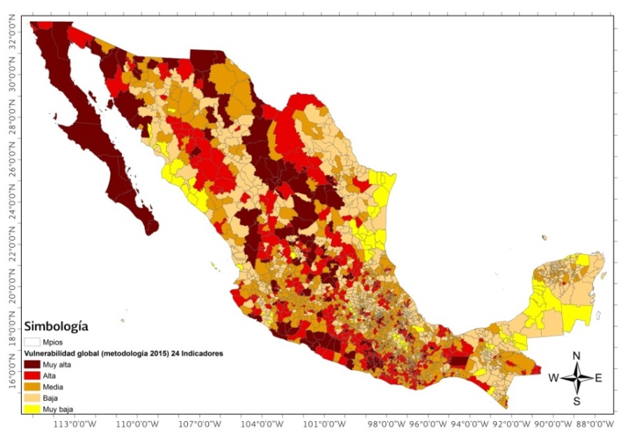
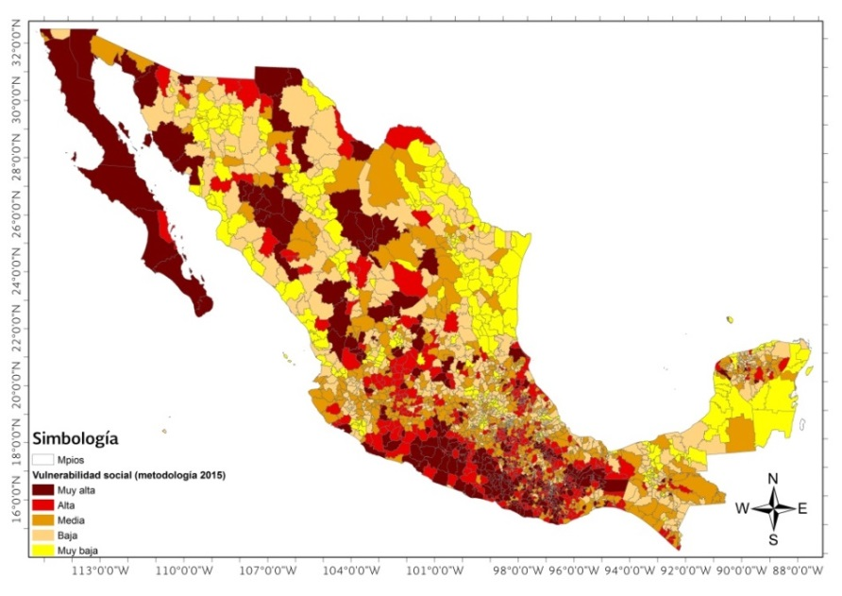
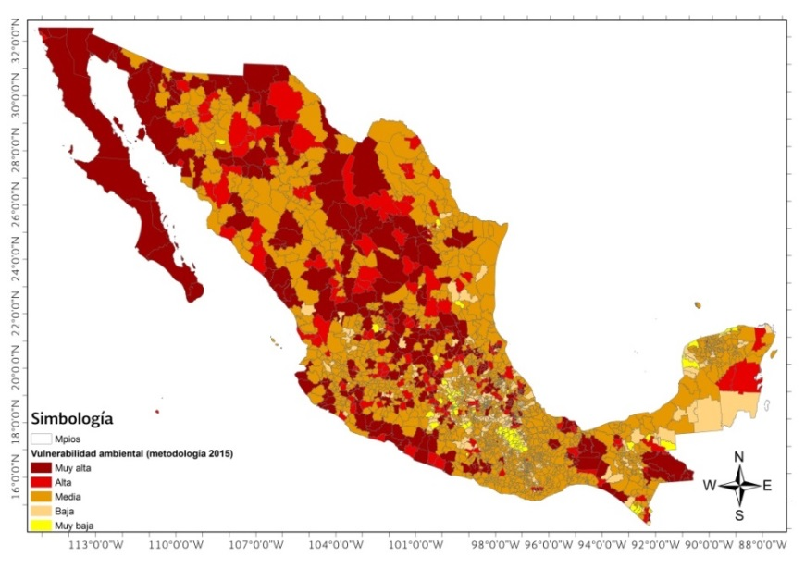
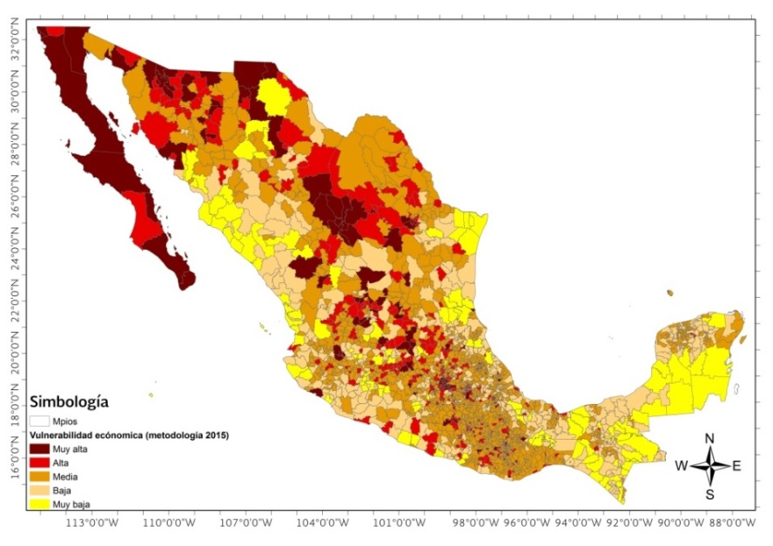
Case Study Mexico (PRONACOSE)
Global
Social
=
+
Economic
Environmental
+

Slide 9
Summary of 24 indicators (2015)
Vulnerabilidad |  | Grado de exposición (GE) | Sensibilidad (S) | Capacidad de Adaptación (CA)
 |  | Indicadores
Global | Económica | Densidad de población (hab/km²) (SEGOB-CONAPO) Población económicamente activa desocupada (%) (SE) | Valor de la producción agrícola de riego y temporal (miles $) (SAGARPA) Valor de la producción del ganado en pie (miles $) (SAGARPA) | Superficie rehabilitada al riego (ha) (CONAGUA) Superficie agrícola tecnificada (ha) (SAGARPA) Longitud de caminos rurales (km) (SCT)
 | Social | Población en condiciones de pobreza (%) (SEDESOL, SEDATU) Población sin derecho-habiencia a servicios de salud % (SS) Población analfabeta (%) (SEP) | Viviendas sin agua entubada (%) (CONAGUA) Viviendas sin drenaje ni excusado (%) (CONAGUA) Viviendas sin energía eléctrica (%) (SENER-CFE) Viviendas con piso de tierra (%) (SEDATU) | Ingreso per cápita anual (dólares) (SHCP) Beneficiarios del programa OPORTUNIDADES (%) (SEDESOL) Beneficiarios del programa LICONSA (%) (SEDESOL) Años promedio de escolaridad (SEP)
 | Ambiental | Grado de explotación de los acuíferos (adim.) (CONAGUA)* Grado de explotación de las cuencas (adim.) (CONAGUA)* | Deforestación (% de área critica forestal) (SEMARNAT-CONAFOR) Superficie afectada por incendios forestales (ha) (SEMARNAT-CONAFOR) | Superficie reforestada (ha) (SEMARNAT-CONAFOR) Áreas naturales protegidas (% de área) (CONANP)
*Estos dos indicadores están contemplados en los tres tipos de vulnerabilidad: económica, social y ambiental.

Slide 10
Vulnerability study in Chile
Objectives/ specific target group
incluiding agricultural factors
Selected Indicators
Data available
Measurable
Representative or proxy of a specific aspect of the problem
Nonredundant
Available at high spatial resolution
Updated ‘regularly’ (every 5-10 years)
Economic Vulnerability
Social Vulnerability
Environmental Vulnerability
Agricultural Vulnerability

Slide 11
Vulnerability |  | Grade of Exposure | Sensitivity | Adaptation Capacity
 |  | Indicators
Global | Economic | Population density Unemployed economically active population | GVA of agricultural production under irrigation GVA of livestock production | Commitment of private and public sector in R&D Water Resources Development and Infrastructure (Dam storage capacity, Contribution of desalinization and contribution of waste water recycling)
 | Social | Population in conditions of poverty Population without medical assistance | Household living quality (tab water, electric energy, sanitary system, basic services, status of the house) | Annual income per capita (GDP), taking into account the Gini-coefficient Average years of schooling above age of 24 + population literacy
 | Environmental | Exploitation grade of water resources (rivers, aquifers,…) | Deforestation Area affected by forest fires | Reforested area Protected natural areas
 | Agricultural | Probability of seasonal crop moisture deficiency Soil root zone water holding capacity | Fragmentation of land tenure | Area rehabilitated through irrigation Area with technified agriculture Proportion of agricultural area covered by Agroseguros (insurance for agricultural production) Beneficiaries of INDAP programs

Slide 12
Indicators for Agricultural Vulnerability
Climate & crop: Probability of seasonal crop moisture deficiency (Ge) (Wilhelmi and Wilhite, 2002)
Soils: Soil root zone Water-holding capacity (Ge) (Wilhelmi and Wilhite, 2002)
Fragmentation of land tenure (S) (Santibáñez et al., 2008)
Long term water storage capacity (AC) (De Stefano et al., 2015)
Area rehabilitated through irrigation (AC) (Wilhelmi and Wilhite, 2002)
Area with technified agriculture (AC)
Insurance: Proportion of agricultural area covered by Agroseguros (AC)
Beneficiaries of local INDAP programs (AC)
Notes:
Effect of governmental funding/ subsidies: Beneficiaries of local INDAP programs
Support during drought recovery: Agroseguros

Slide 13
Thank you!
www.unesco.org/water
k.verbist@unesco.org

