Slide 1
Climate Risk Informed Decision Analysis: Bridging the Gap between Science, Engineering, and Policy
Kristin Gilroy, PhD
International Center for
Integrated Water Resources Management
24 February 2016

Slide 2
Alliance for Global Water Adaptation (AGWA) (http://alliance4water.org/index.html)
Nov 2011 Workshop hosted by the World Bank: “Including Climate Change in Hydrologic Design [..]”
Problem to make decisions under climate change and navigate through tools and best practices?
AGWA Core team created:
World Bank, IWR, SIWI, Deltares, U. Massachussets-Amherst, Pegasys, Rijkswaterstaat
Climate Risk Informed Decision Analysis:
A technical guidance for water resources managers, donors, agencies
A community of practice to innovate by sector and region
A complement to the World Bank ‘Decision Tree’

Slide 3
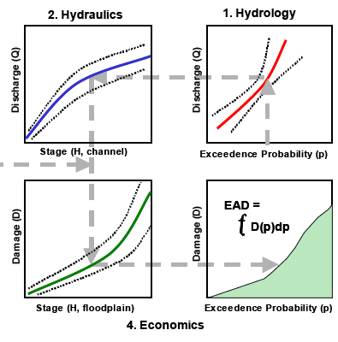
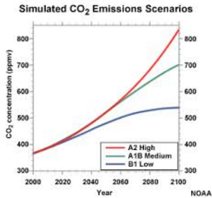
Purpose of CRIDA
Engineers have always dealt
with uncertainty
What has changed?
How should engineers incorporate climate change information into the water management planning process?
Safety Margins/
Freeboard
Identify Problems and Opportunities
Vulnerability Assessment: Current and Future
Formulate alternative plans
Evaluate alternative plans
Compare alternative plans
Select alternative plan
Uncertainty does not stop
decision making
Water Management Planning Cycle
Nonstationarity
“Deep Uncertainty”
Notes:
We make decisions based on observed data, sometimes the sample size is too small, sometimes it’s not available so we rely on regional data instead. How do we cope with these? Our policies add in safety margins and free board… What’s new??? Climate change, nonstationarity. Now, our uncertainties expand beyond statistical uncertainties which can be defined with confidence intervals. Now, we don’t even know what probability distribution we are dealing with. That’s daunting…..
Discuss where climate uncertainty enters the planning process (Vulnerbality assessment. Always estimate future socio-economic conditions)
In many places, guidance is lacking regarding what future climate conditions to consider and/or how to consider them. Even if guidance is given (i.e., Specify which GHG emissions scenario to use), there are known challenges with the available climate data, which many in this room are working to fix (i.e., time scale, lack of observed data for downscaling, known issues in certain geographic areas)
CRIDA is meant to provide guidance at different decision points along the planning cycle, and ensure that the level of analysis matches the problem at hand and the quality of available information.
The IPCC … “has led to abundance of publicly available data and information on potential impact of climate change, such as the CMIP5 global circulation model outputs (IPCC, 2015), but lack of expert knowledge from the user side has limited the use of this information to effectively develop and implement adaptation strategies to climate change at the local level. This mismatch needs to be addressed in order for vulnerable water-stressed communities to benefit from the foresight provided by climate science.”
Our Audience: the engineer/planner/analyst on the ground who is asked to develop a climate adaptation strategy, but doesn’t know where to start.

Slide 4
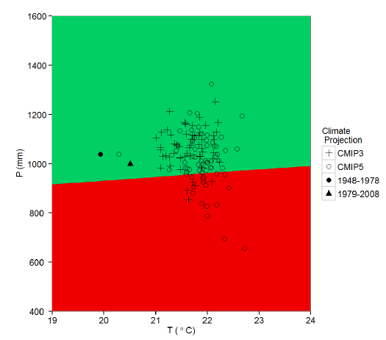
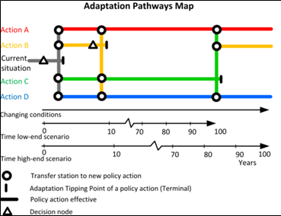
Two Key Elements of CRIDA
Decision Scaling
Adaptation Pathways
Available climate data doesn’t always meet the problem at hand: time-scale differs, models perform poorly in geographic region, observed data not available for downscaling
Limiting analysis to GCM derived scenarios confines your decision space
Allow stakeholders to define system failure
With limited information, decision makers risk over- or under-designing solutions
Adaptation pathways illustrate flexible strategies to the decision maker
Choosing an action that has many transfer points in the future provides a low regret option as the science progresses
Climate Response Map for a Proposed
Run-of-the-River Hydropower Project (Ray and Brown, 2015).
Notes:
Two key elements which CRIDA adds to the planning cycle include: Decision Scaling and Adaptation Pathways
Decision scaling: is a bottom up approach to a vulnerability assessment of your system, which is the first time climate information enters the planning process. I will go into it in detail on the next slide.
Adaptation pathways: is a new method, developed by Deltares in the Netherlands, to develop and present flexible strategies to the decision maker.
Climate information comes into play on the x-axis – can we put time estimates on these changing conditions???? How confident are we in them???

Slide 5
Where does CRIDA Fit into Planning Cycle? How does it influence decision making?
Identify Problems and Opportunities
Vulnerability Assessment: Inventory and forecast conditions
Formulate alternative plans
Evaluate alternative plans
Compare alternative plans
Select alternative plan
Decision Scaling
Water Management Planning Cycle
Decision Point 3:
Influence of institutional/gov’t capacity?
Decision Point 1: Level of Analysis
Adaptation Pathways
Decision Point 2:
Additional Decision Criteria?
Notes:
Use our assessment of climate risk and climate uncertainty/confidence to influence Decision Points 1 and 2….

Slide 6
We need your help!!!
Water Resources System Type | Key Hydrology Statistic | Confidence & Existing Tools
Rainfall dependent water Supply System | Variability of flow or rainfall (monthly) Persistence (or auto-correlation) of low flows or rainfall (monthly) | ??????
Glacial dominated water Supply System | Persistence of high mean temperatures (weekly? monthly?) | ??????
Flood Risk Reduction System | Maximum annual peak flow (daily) Intensity-Duration-Frequency Curve (sub-daily) | ??????
Coastal Risk Reduction | Mean sea level (annual) | ??????
Ecological | All the above | ??????
Are those climate states plausible, suggesting high climate risk?
How much uncertainty is there in available climate information?
Notes:
Depending on the climate information required to meet the needs of the water resources problem, how well do these models perform??? How much should the decision makers trust them??? How much should analysts invest in them??? What tools are out there to improve them???

Slide 7
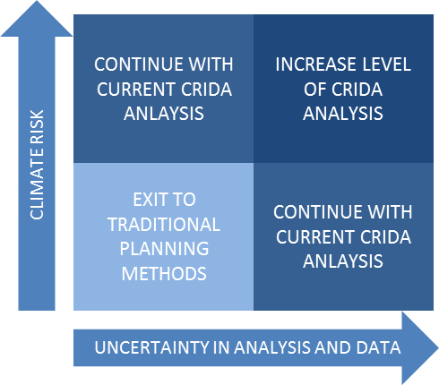
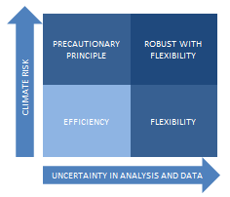
What does CRIDA add to traditional planning approaches?
A broader vulnerability assessment
Guidance on the necessary level of analysis
Adaptation pathways to illustrate the flexibility
Guidance on preferred pathway decision criteria & role of institutional capacity
Notes:
A broader vulnerability assessment which does not limit decision space to selected scenarios. This has the potential to show benefits of alternatives which build additional robustness into system at little additional cost.
We may also end up eliminating alternatives earlier because our threshold approach to robustness may be stricter than a target approach.
Guidance on the necessary level of analysis (i.e., need for climate risk analysis or traditional planning , downscaling) based on Level of Concern analysis which considers the confidence in available data, consequences within system, and available resources should influence decision making
Development of adaptation pathways to illustrate the flexibility of selected strategies. Another benefit is the visual aspect of presenting potential strategies to decision makers.
Guidance on preferred pathway criteria ranging from flexibility and immediacy of investment based on the Level of Concern analysis as well as institutional capacity.

Slide 8
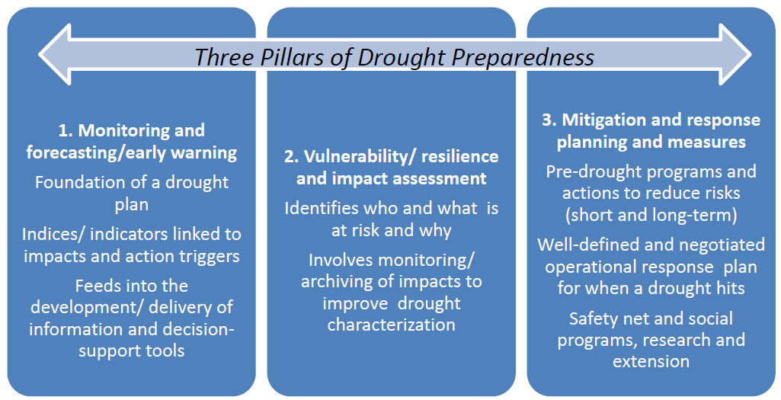
Where does CRIDA fit in the 3 Pillars of Drought Preparedness?
Notes:
Monitoring and forecasting/early warning
this is needed to supports our approach if an adaptive management plan is selected
Vulnerability/resilience and impact assessment
is necessary as part of our method, our bottom-up approach may be used. We only do this once to develop a plan
Mitigation and response planning and measures
Pre-drought programs and adctions to reduce risks; short term and long term
We would be involved in the more long term (20-yr plans)
Well-defined and negotiated operational response plan for when a drought hits
On the operational side, we could be involved in planning (i.e., water allocation, operation rules)
Safety net and social programs, research, and extension
All of these would be part of a long term plan, ‘buying down risk’ from drought

Slide 9
What still needs to be done?
Guidance Manual
Community of Practice
Continue to revise and improve approach
Specific area : Assessment of available climate information
Developed by USACE, U. Mass and Deltares
Expected Publication Date: Summer 2016
Trainings
Other?
World Bank?
UNESCO IHE
First meeting: May 2016
Case Studies…
Collaboration and Integration Opportunities w/
Climate Services for Enhanced Water Management Project
Activity 1: Improve integrated drought risk management towards a policy for drought preparedness
Activity 2: Training of multiple stakeholders to strengthen capacities on climate services targeting water resources management and to increase resilience to climate hazards
Activity 3: Strengthening of the community of practice on dryland management (GWADI-LAC) to support development and implementation of climate risk management in the region
Activity 4: Implementation of climate services to improve water management across spatial and temporal scales
Activity 5: Building climate resilient watersheds while enhancing their ecosystem services
Notes:
So many aspects of our next steps fit in line with the activities in this project:
Looking forward to discussing possibilities for integration and collaboration.

Slide 10
Questions?
“Solum certum nihil esse certi”
(the only certainty is uncertainty)
- Pliny the Elder (23-79 A.D.), Historia Naturalis

