Slide 1




Climate Change and Water:
Coping with uncertainties at the local scale
with a focus on the mediterranean area
Marnik Vanclooster
UNESCO-IHP-BE meeting 24/2/2016

Slide 2
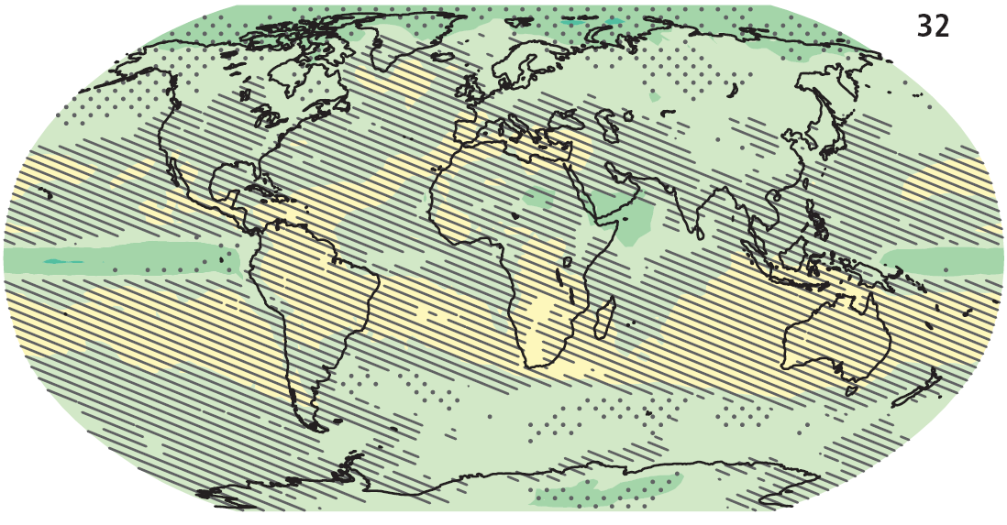
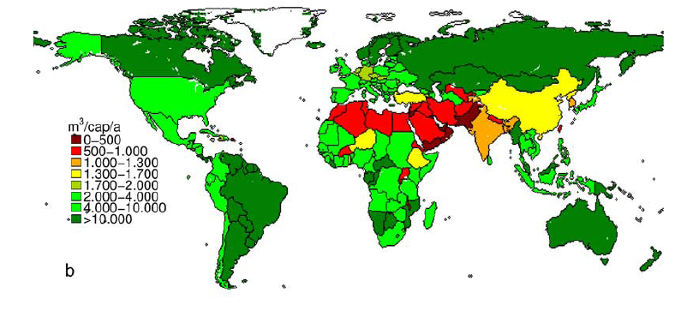
Focus on the mediterranean

Slide 3
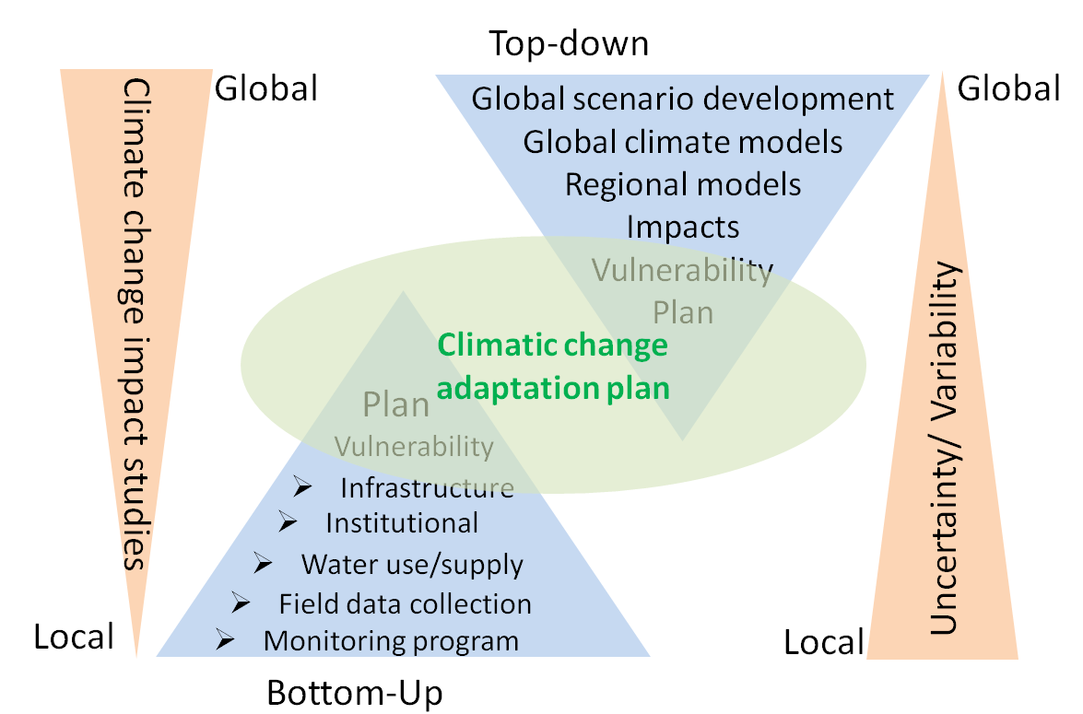
Focus on the mediterranean
Sellami et al., 2014

Slide 4
Focus on the mediterranean
Climate Change Impacts on Water and Security in Southern Europe and neighbouring regions
(EU-FP7)
  CLIMB: Climate Induced Changes on the Hydrology of Mediterranean Basins
  CLICO: Climate Change, Hydro conflicts and Human Security
  WASSER Med :Water Availability and Security in Southern Europe and the Mediterranean
Ludwig et al., 2014

Slide 5
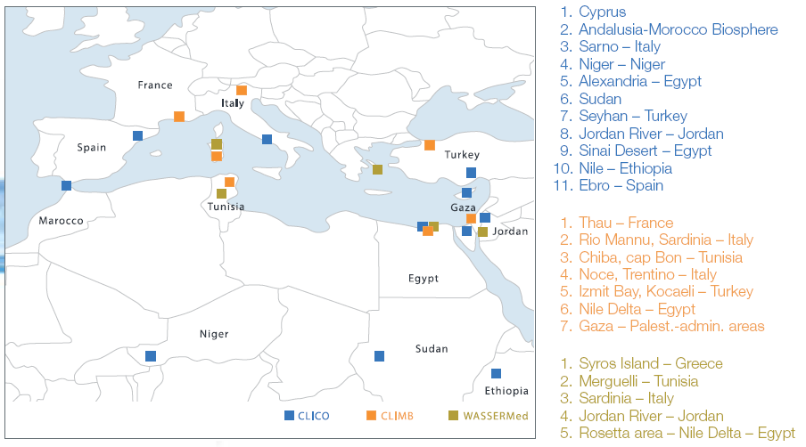
Ludwig et al., 2014

Slide 6
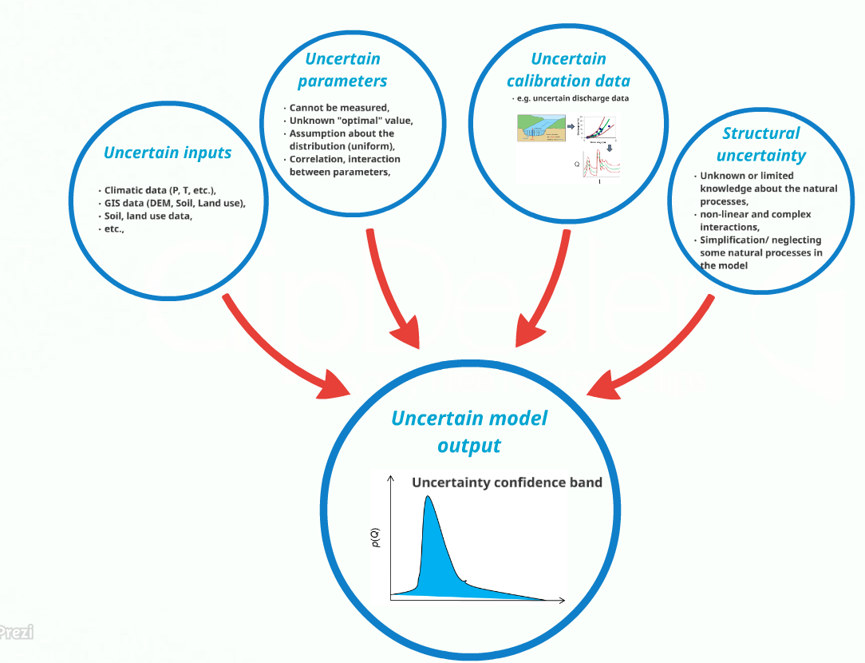
Introducing uncertainty in local scale hydrological impact assessments
Sellami et al., 2014

Slide 7
Introducing uncertainty in local scale hydrological impact assessments
Study Site Characterization
Conventional data (soil, DEM,
vegetation, water availability
and consumption etc.)
GCM / RCM
1
GCM / RCM
2
GCM / RCM
n
Climate Model
Audit & Uncertainty Assessment
Socioeconomic Factor
Assessment
Remote Sensing
Hydrological
Models
Audit &
Uncertainty
Assessment
Risk Model
Vulnerability
& Risk
Assessment
Hydrological Model 1
Parameter retrieval &
Data assimilation
Hydrological Model 2
Geophysical Data
Acquisition
Hydrological Model n
Dissemination & Stakeholder Interaction
(Interviews, WebGIS, Website, CLIMBPortal)
Sellami et al., 2014

Slide 8
GCM
HCH
Hadley Center for Climate Prediction, Met Office, UK. HadCM3 Model (high sensitivity)
ECH
Max Planck Institute for Meteorology, Germany. ECHAM5/MPI OM
(A1B)
(A1B)
RCM
RCA
Swedish Meteorological and Hydrological Institute (SMHI), Sweden
RCA Model
REM
Max Planck Institute for Meteorology, Hamburg, Germany
REMO Model
RMO
Royal Netherlands Meteorological Institute (KNMI), Netherlands
RACMO2 Model
Selected GCM-RCM
HCH-RCA
ECH-RCA
ECH-REM
ECH-RMO

Slide 9
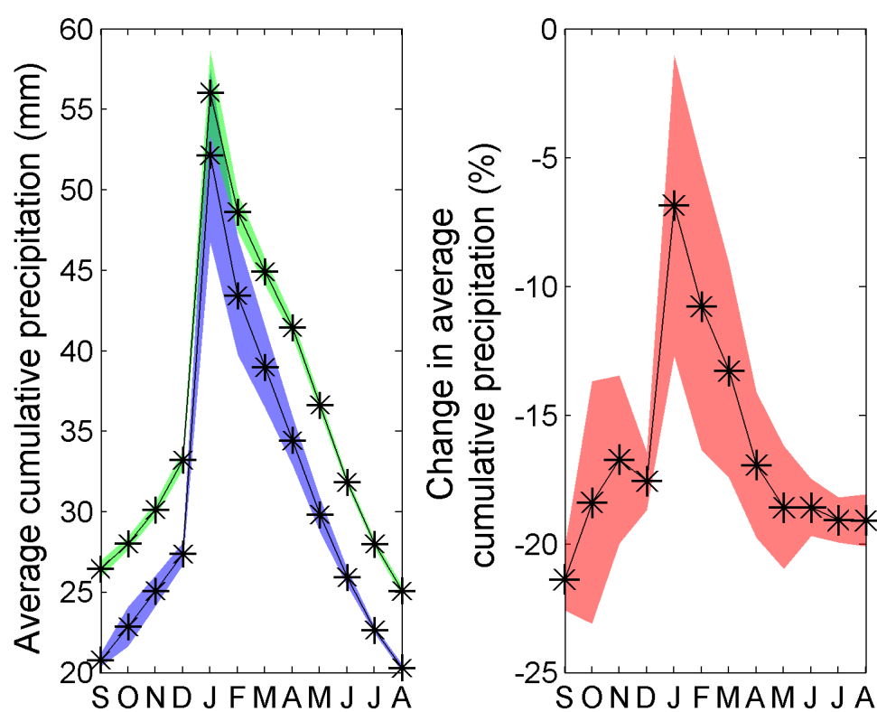
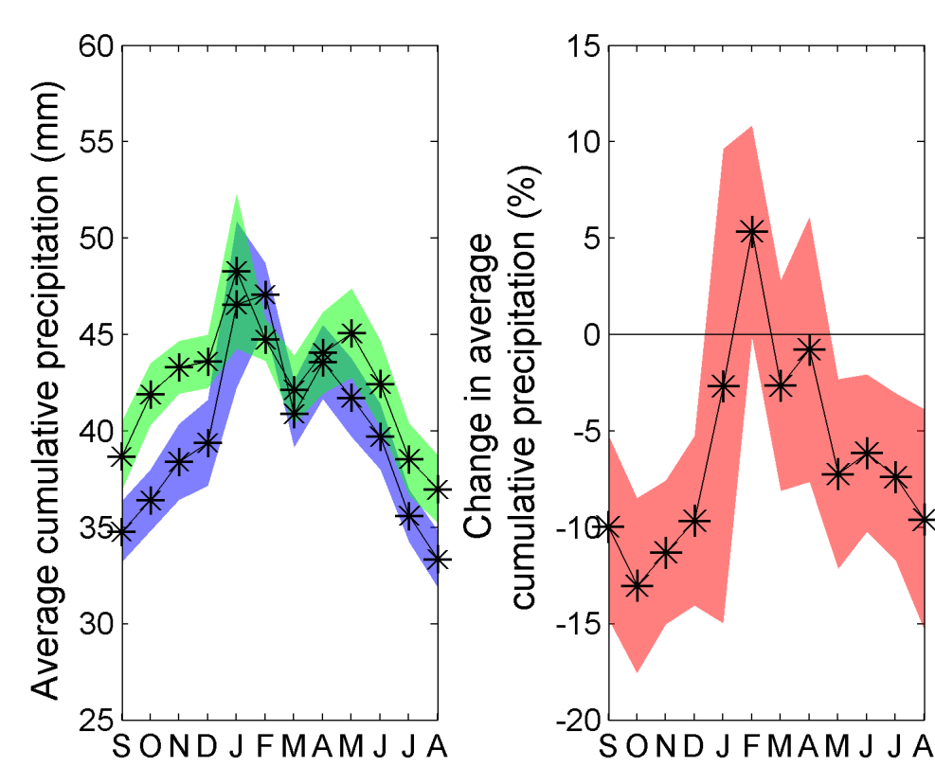
Introducing uncertainty in local scale hydrological impact assessments
Chiba catchment (Tunisia)
Thau catchment (France)
  General decrease in precipitation (1971-200 Vs 2041-2070)
Sellami et al., 2014

Slide 10
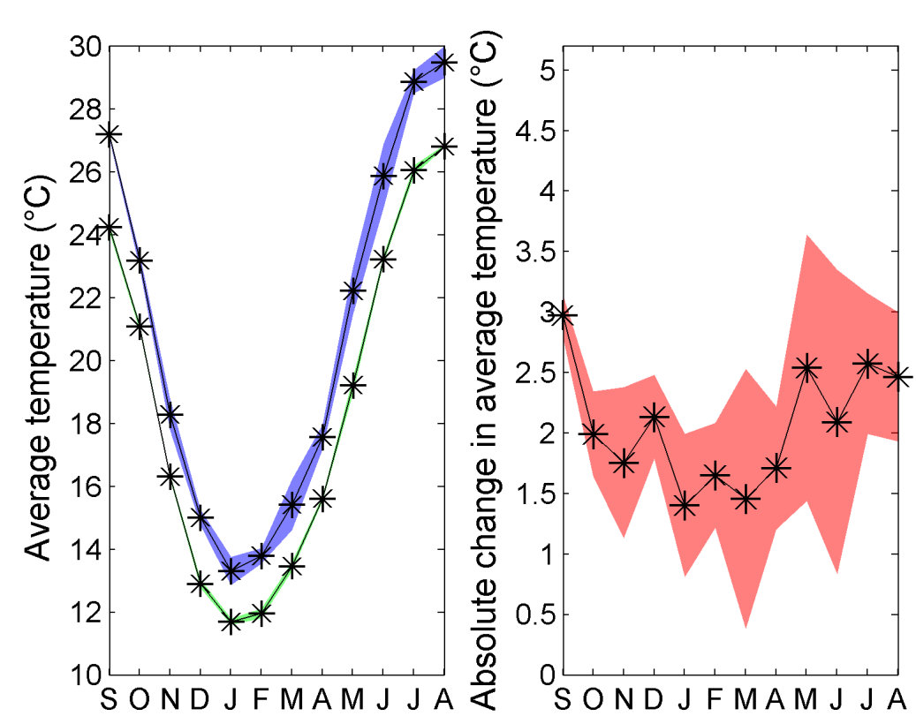
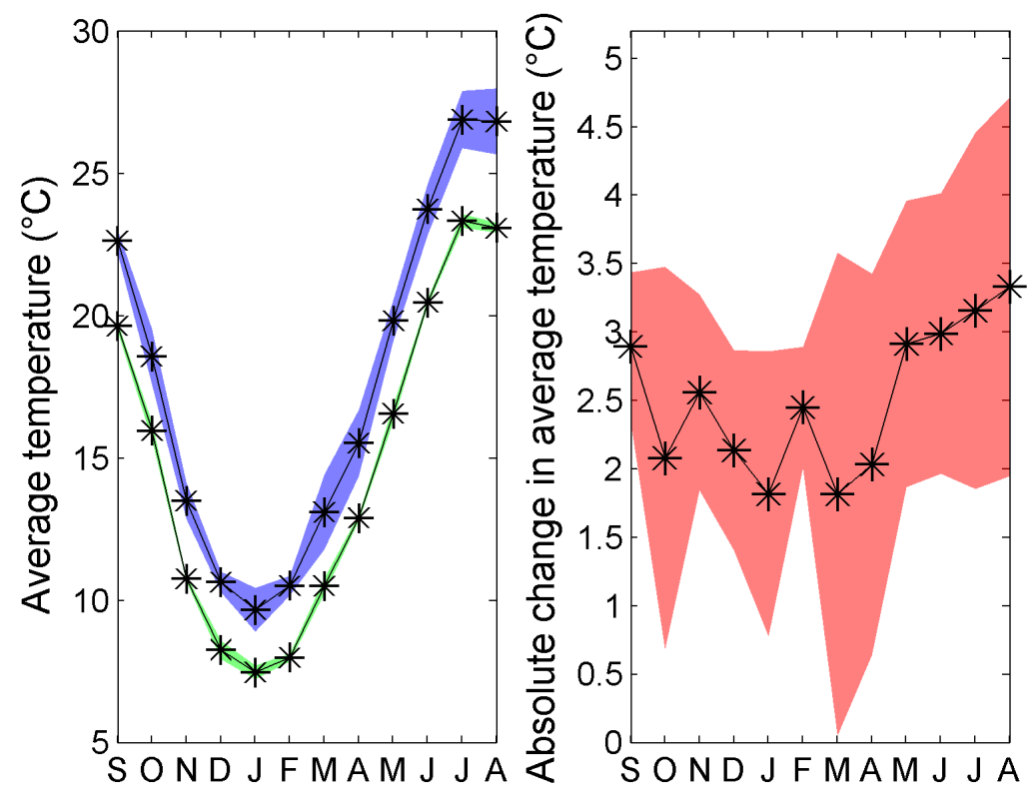
Introducing uncertainty in local scale hydrological impact assessments
Chiba catchment (Tunisia)
Thau catchment (France)
  General decrease in temperature (1971-200 Vs 2041-2070)
Sellami et al., 2014

Slide 11
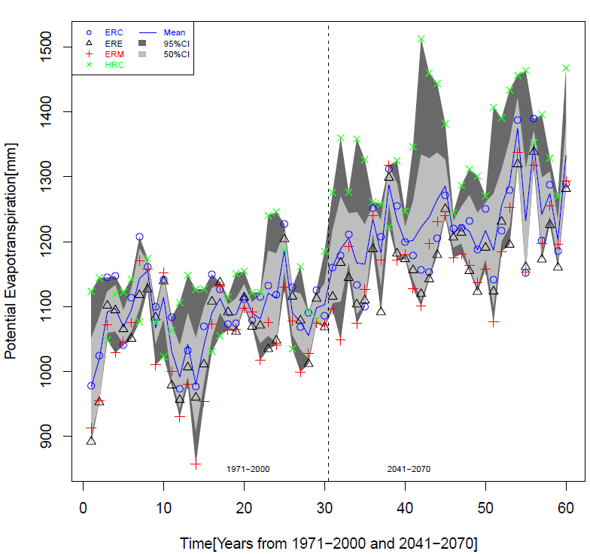
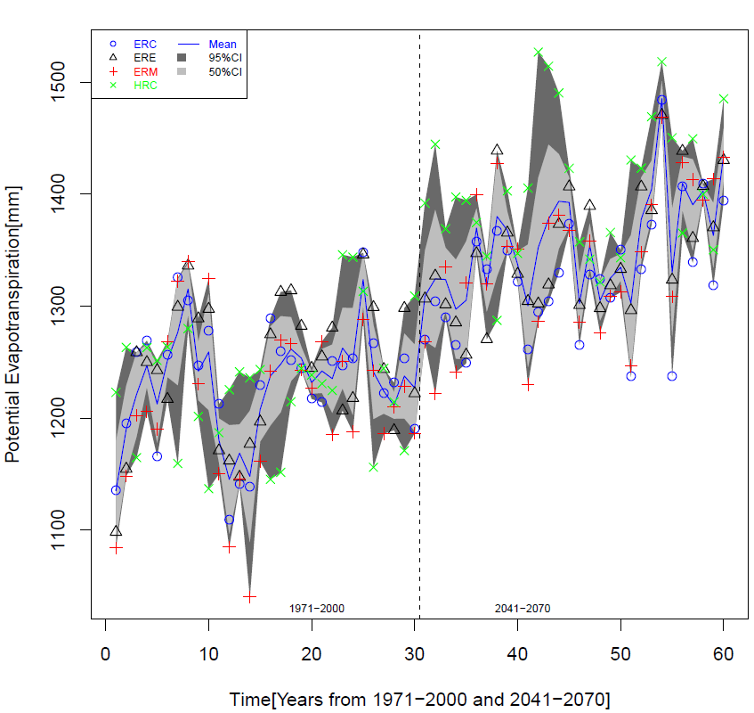
Introducing uncertainty in local scale hydrological impact assessments
HM WASIM
HM SWAT
  + Similar trend: general increase in PET (1971-2000 Vs 2041-2070)
  - Uncertain projected magnitude (model structure uncertainty)
Sellami et al., 2014

Slide 12
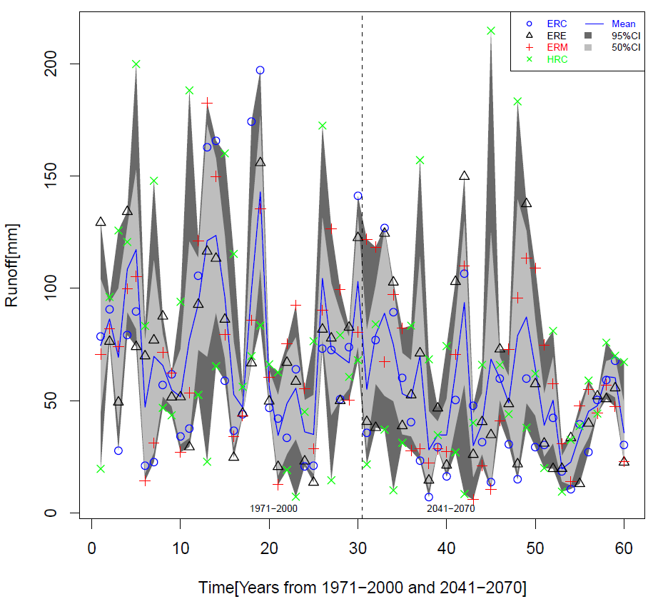
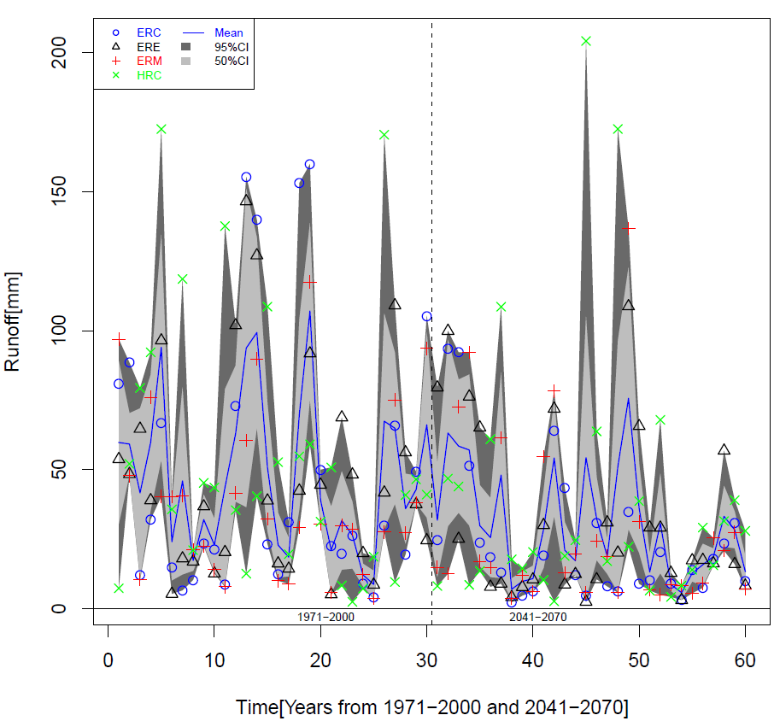
Introducing uncertainty in local scale hydrological impact assessments
HM WASIM
HM SWAT
  + Similar trend: general decrease in Run (1971-2000 Vs 2041-2070)
  - Uncertain projected magnitude (structural uncertainty)
Sellami et al., 2014

Slide 13
Introducing uncertainty in local scale hydrological impact assessments
Sellami and Vanclooster, 2013

Slide 14
Introducing uncertainty in local scale hydrological impact assessments
Source | Vene | Pallas
Hydrological model parameter | 72 % | 86 %
Rating cruve | 28 % | 14 %

Slide 15
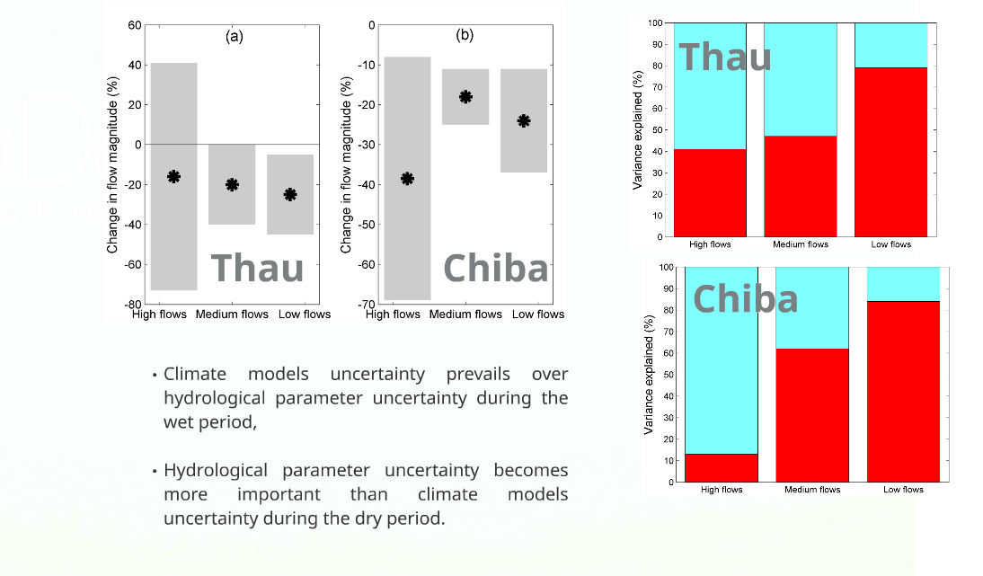
Introducing uncertainty in local scale hydrological impact assessments
Sellami et al., 2014

Slide 16
Lessons that I’ve learned
Impact assessments of CC on hydrology in some local mediterranean catchments are consistent with the global assessments for this region (i.e. more important droughts are expected).
Uncertainty on impact assessments remains high.
Hydrological parameter uncertainty dominates climate uncertainty for predicted droughts.

Slide 17
Key message from CLIMB
Climate change contributes, yet in strong regional variation, to water scarcity in the Mediterranean; other factors, e.g. pollution or poor management practices are regionally still dominant.
Tourism could benefit in colder seasons, but may expect income losses in the summer peak season due to increasing heat stress.
Emerging focus areas are supplies of domestic drinking water, irrigation, hydro-power and livestock
Rain-fed agriculture needs to adapt to seasonal changes
Stable or increasing productivity likely depends on additional irrigation.
Local & regional water managers and water users, lack, as yet, awareness of climate change induced risks;
Data and knowledge gaps in climate change impact and risk assessment are still wide-spread and ask for extended and coordinated monitoring programs

Slide 18
Key messages from: Wassermed
The warming trend and changes in precipitation patterns could affect the composition and functioning of natural & managed ecosystems.
Growing non-agricultural water needs will strongly affect agricultural water shortages in the Southern Mediterranean;
Water resources for environmental preservation, are likely to de-crease, especially in the MENA region.
Intra-Mediterranean virtual water trade is likely to decline, with virtual imports from central and northern Europe increasing.
Improved water efficiency appears to significantly mitigate the economic impacts of water scarcity, especially in the Northern areas.
A seasonal change in tourism is probable due to improving climate conditions in spring and autumn and a slight deterioration in summer.
Crop water requirements are very likely to increase in all case studies, requiring specifically adapted management practices

Slide 19
Key messages from: CLICOL
There is no evidence of a link between hydro-climatic variability and domestic water conflicts.
Democracies are likely to have more domestic water conflicts than autocracies, but autocracies are likely to have more violent water conflicts than democracies.
Wars and violence increase the vulnerability of the population to hydro-climatic hazards.
States often maladapt, that is they pursue adaptation policies that end up increasing, instead of decreasing, the vulnerability of large parts of their population.
Social security and civil security institutions – such as entitlement schemes, unemployment insurance, universal health care, or flood relief agencies – are central for reducing vulnerabilities and providing human security

Slide 20
What we plan to do in the future:
SMARTer monitoring
Advanced field data monitoring and assimilation studies
  Tunisia:
    Cooperation with DRH, ESIER, FS Tunis, ENIT, INAT, CERTE (EU-JPI, WBI, Erasmus+)
  Maroc:
    Cooperation with IAV, UMP, DRH, ORMVA.. (ARES-CCD, WBI, CTB)
  Algerie:
    Cooperation with U (IDB, CTB)
Citizen science

Slide 21
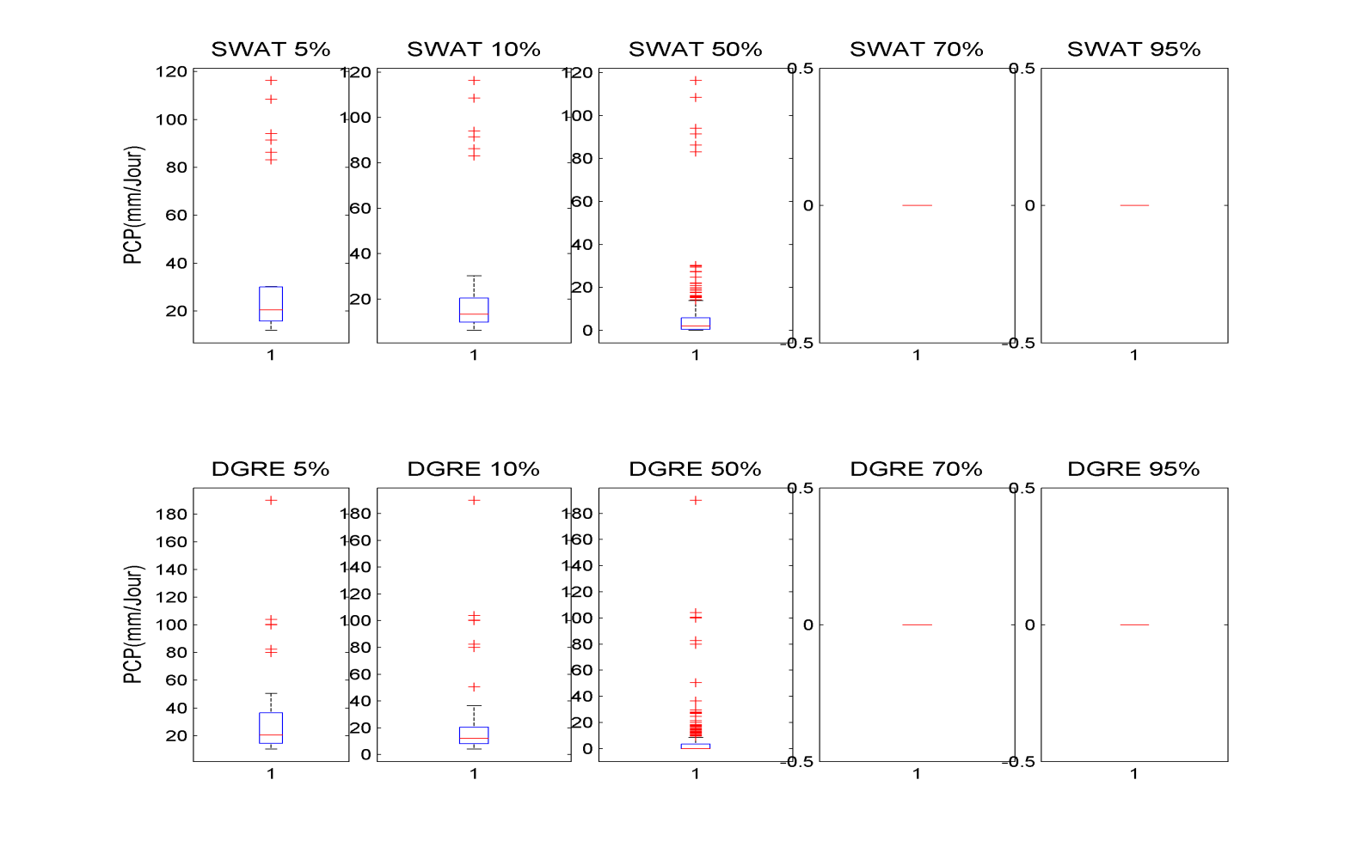

Slide 22


Stratégie de sensibilisation
Utilisation des smartphones
Global Data Base
Traitement de l’information et extraction des données

Slide 23
What we plan to do in the future:
Integrate more groundwater in CC adaptation strategies

Slide 24
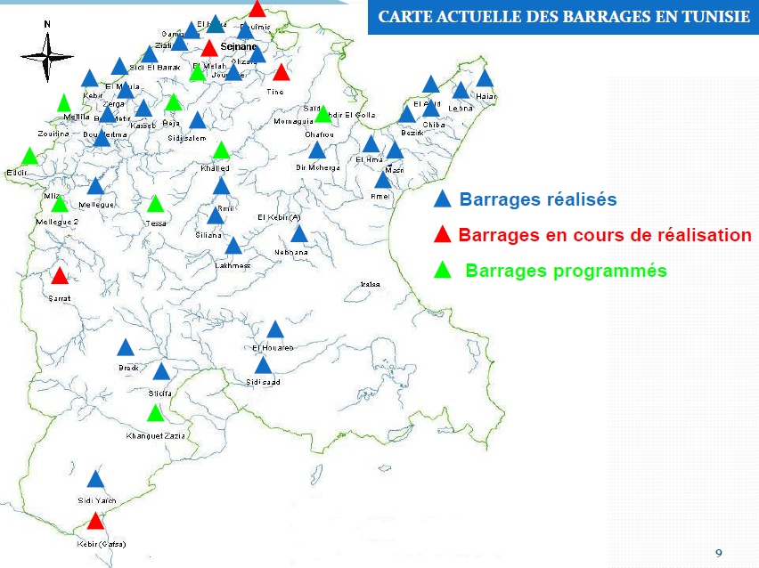

Slide 25
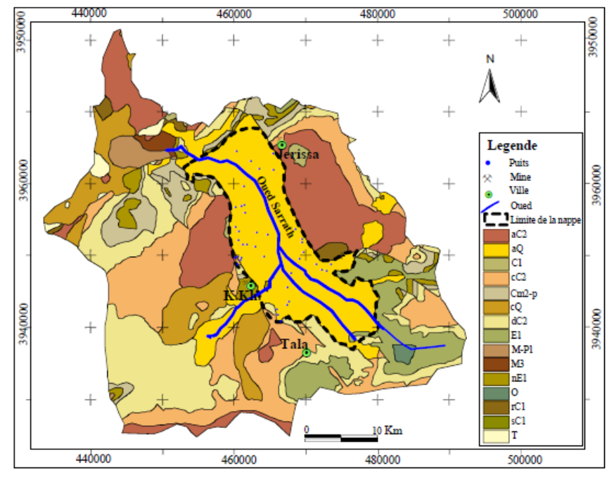
Figure 6.Extension spatiale de la plaine de Kalaa Khasba
(Bel Haj Ali et al., 1985,modifié par Mlayah, 2010).

