Slide 1
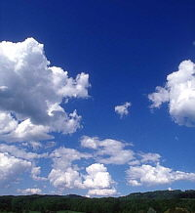

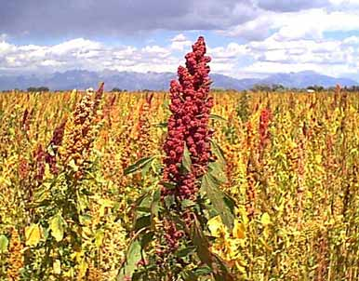
Potentiality of using deficit irrigation for quinoa in the Bolivian Altiplano
Lessons learnt
QUINAGUA VLIR-UMSA
Coordinators:
Prof. Dr. Dirk Raes (KULeuven)
Prof. Dr. Magali Garcia (Fac. Agronomia-UMSA)

Slide 2
The project…..
Objetive:
To evaluate the feasibility of increasing marketable yield of quinoa production systems through the use and application of Deficit Irrigation in the Bolivian Highlands.

Slide 3
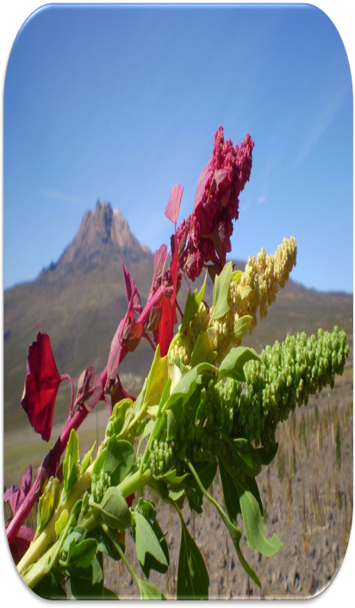
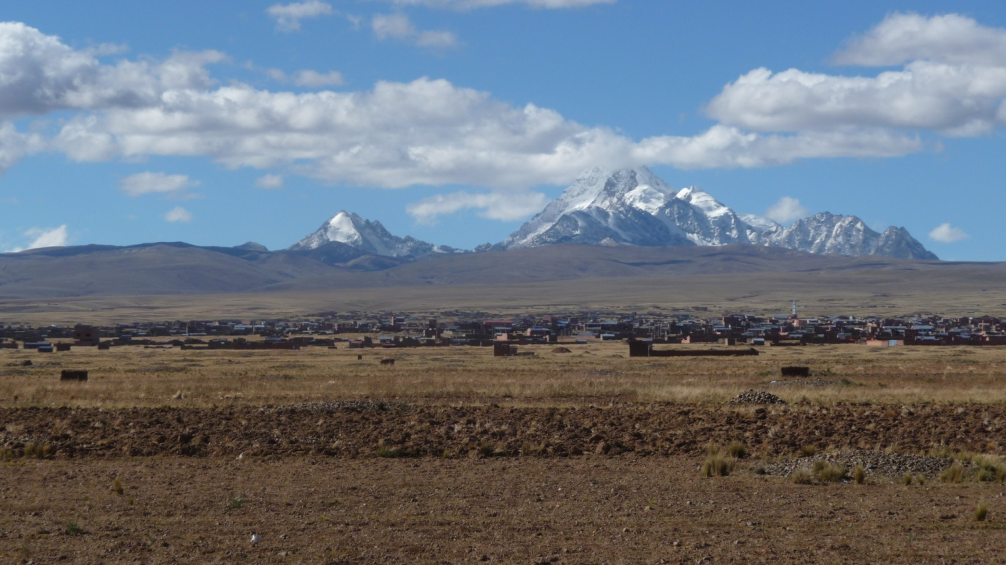
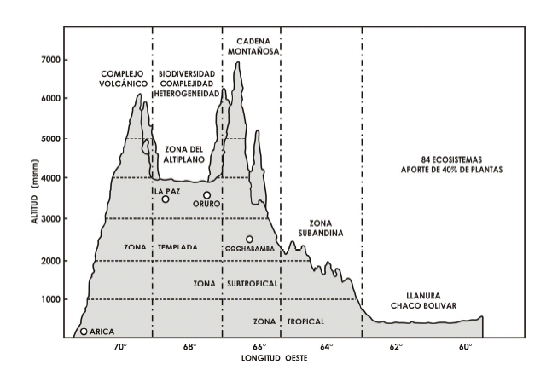
Environmental conditions in the Highlands during the recent past
High altitude (3850 m.a.s.l.),
Highest rate of UV radiation
Low temperatures, long growing periods

Slide 4
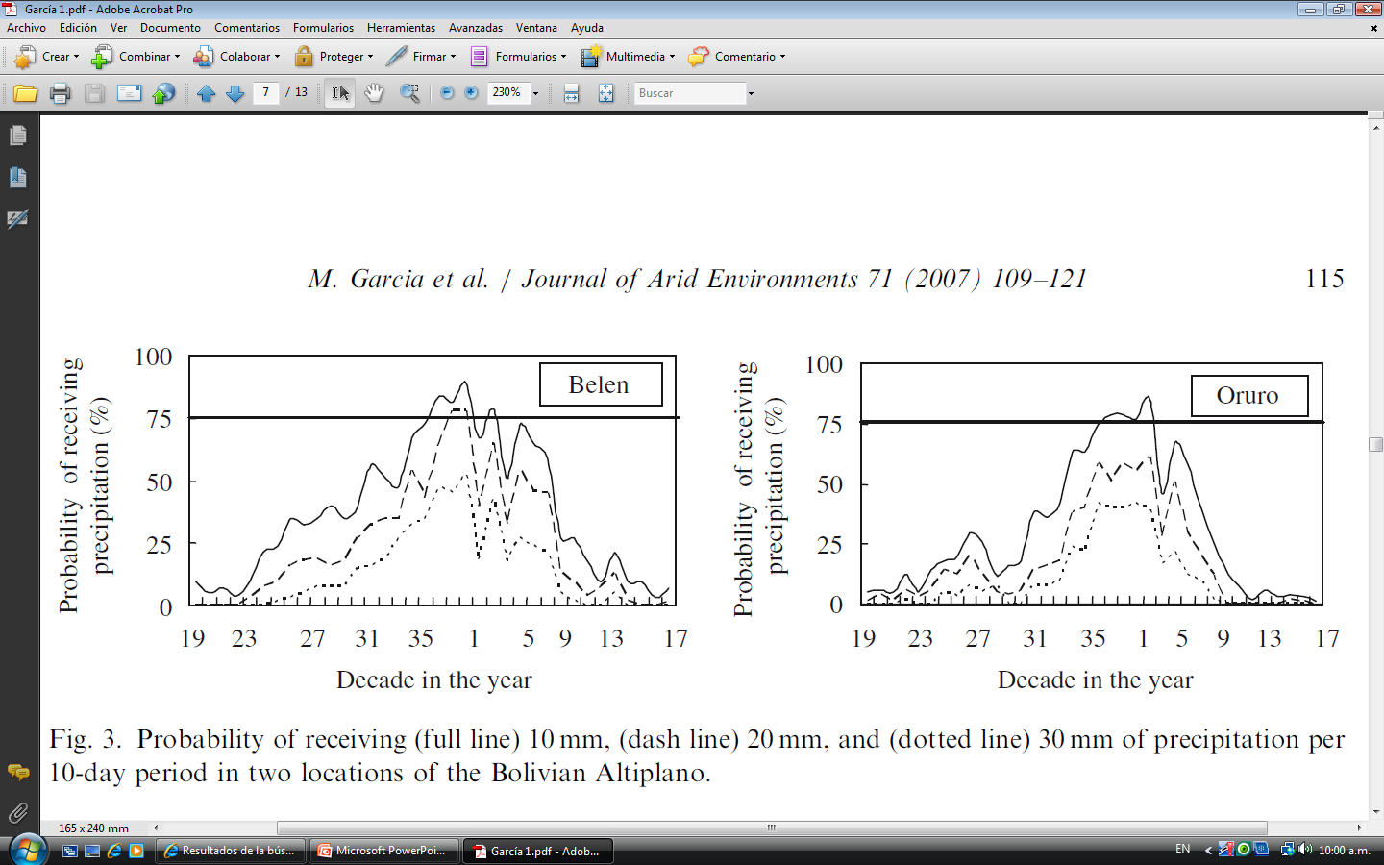
Environmental conditions in the Highlands during the recent past
Concentrated rainfall distribution.
Very high frost risk. In average only 150 frost-free days

Slide 5
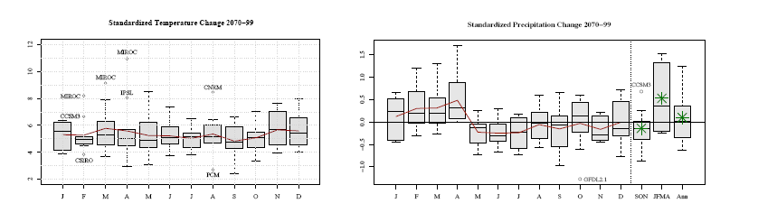
The foreseen climatic conditions….under Climate changed conditions
High altitude (3850 m.a.s.l.), high rate of UV radiation
Higher temperatures, shorter growing periods, then higher and more concentrated ET rates. (more) Erratic distribution of rainfall.

Slide 6
Statistical downscaling results of climatic scenarios
The foreseen climatic conditions….under Climate changed conditions
Strong reduction of frost risk and larger cropping window.

Slide 7
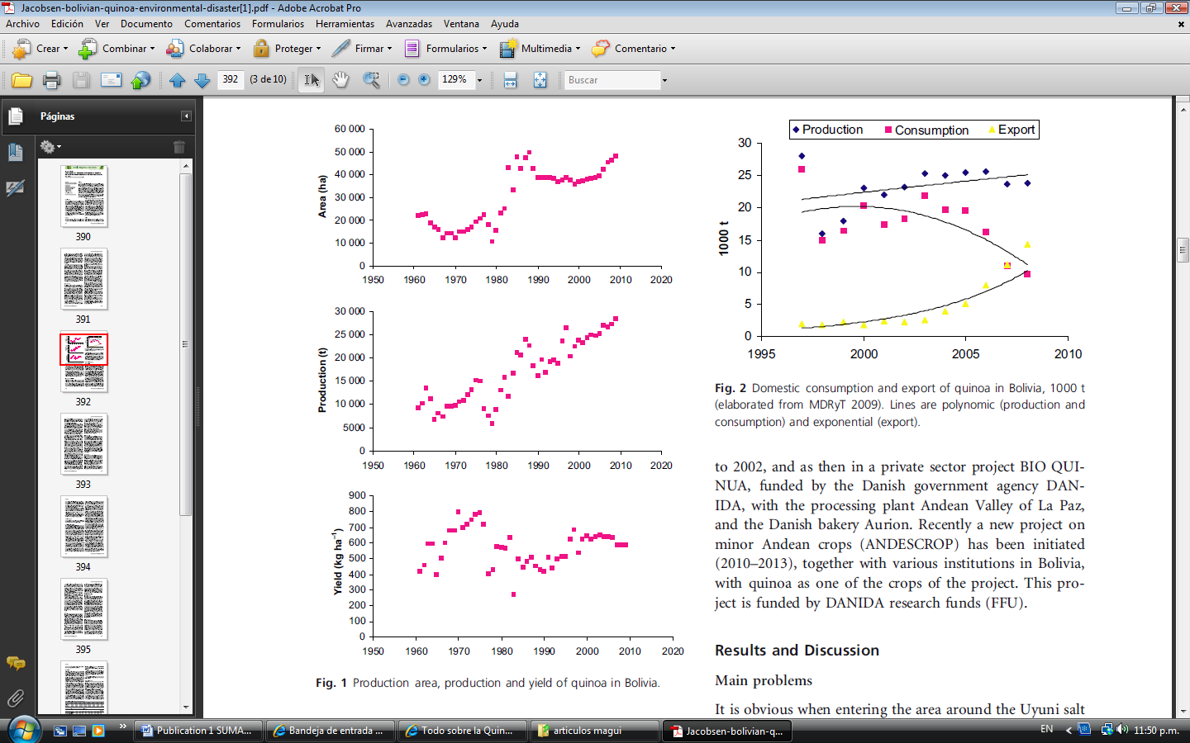
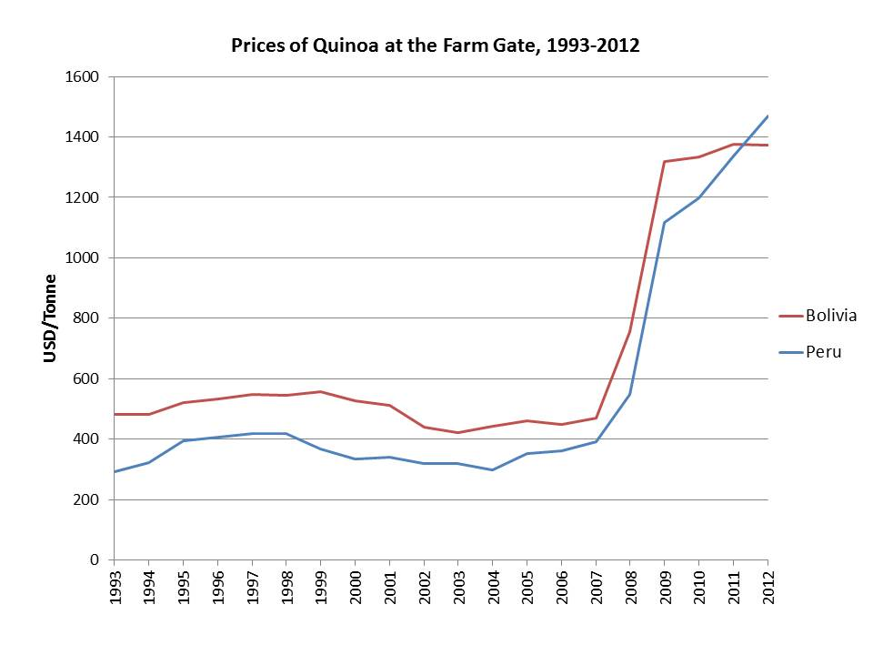
Quinoa marketing environment
Large pressure for better and more efficient water use as complementary irrigation for quinoa.
(from Jacobsen, 2012)

Slide 8
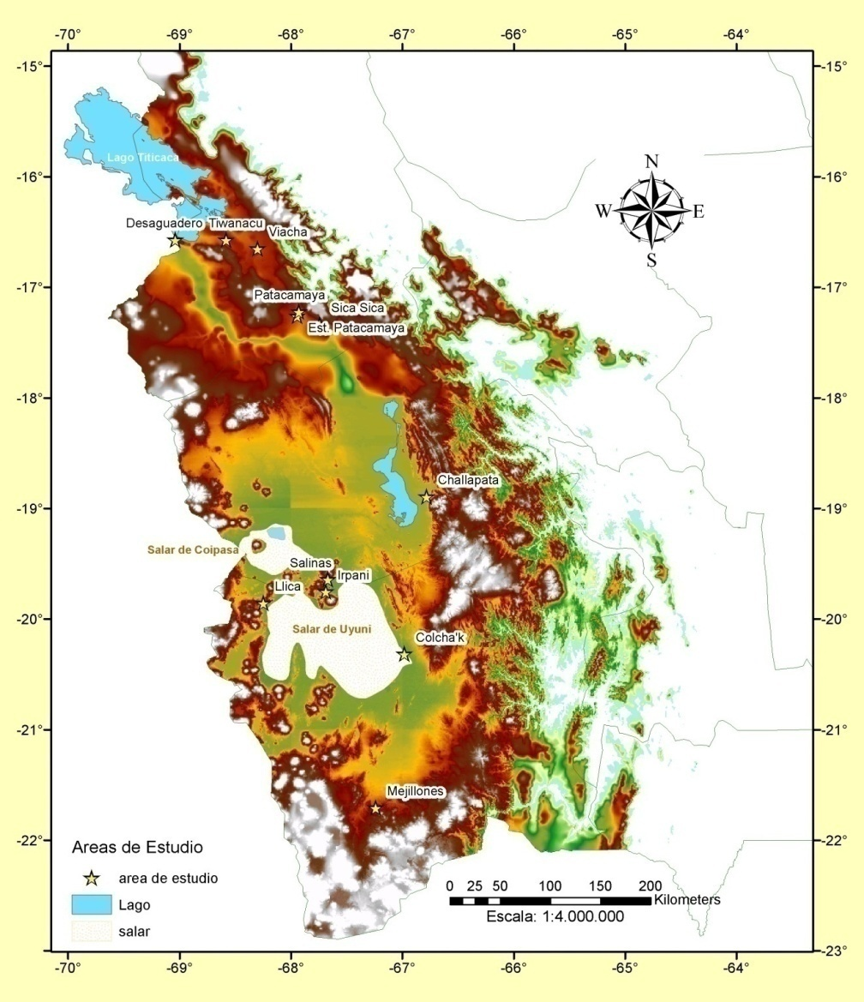
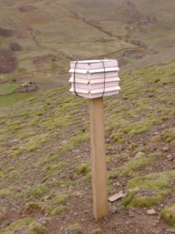
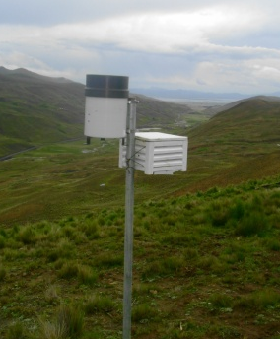
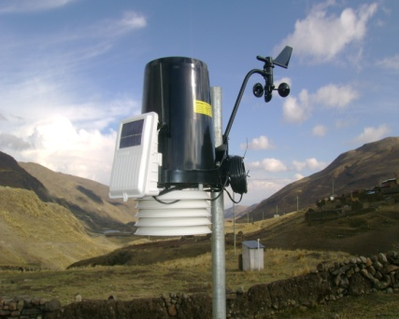
Very well time and place validated conclusions for the highlands

Slide 9
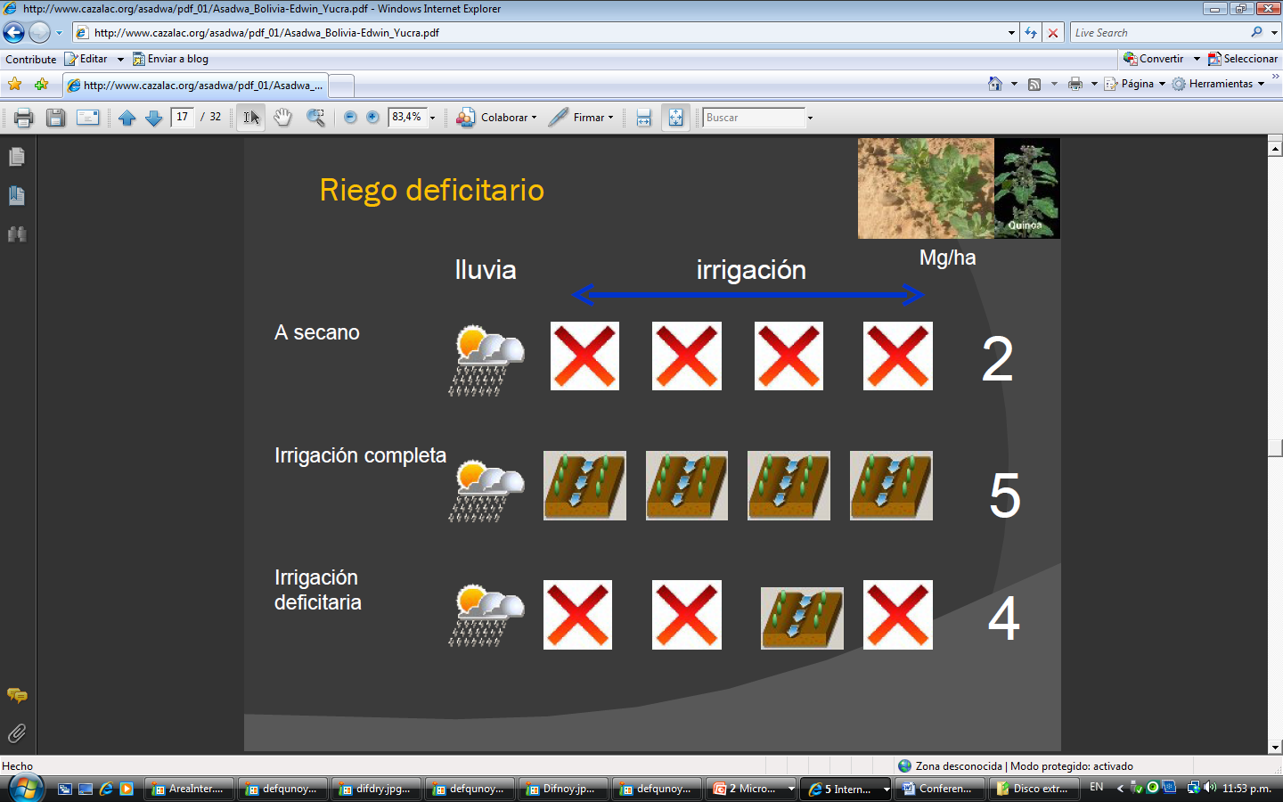
Conclusions about timing of deficit irrigation (assuming a well fertilized soil)
Rainfed
Full irrigation
Deficit irrigation
1300 Kg/Ha
3500 Kg/Ha
2500 Kg/Ha

Slide 10
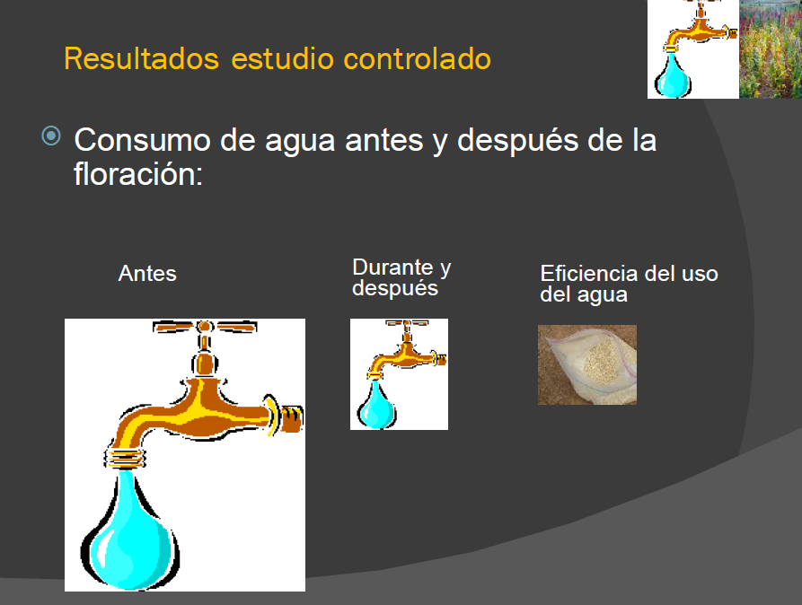
Conclusions about timing of deficit irrigation (assuming a well fertilized soil)
Plant water use before and after anthesis
Before During and after WUE

Slide 11
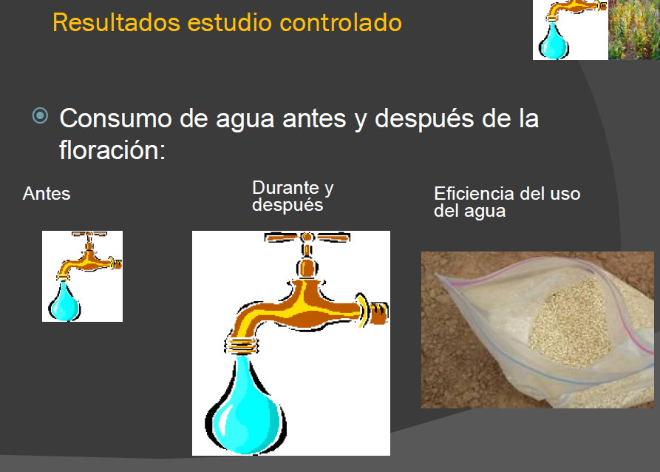
COMPONENTE RIEGO DEFICITARIO
Plant water use before and after anthesis
Before During and after WUE

Slide 12
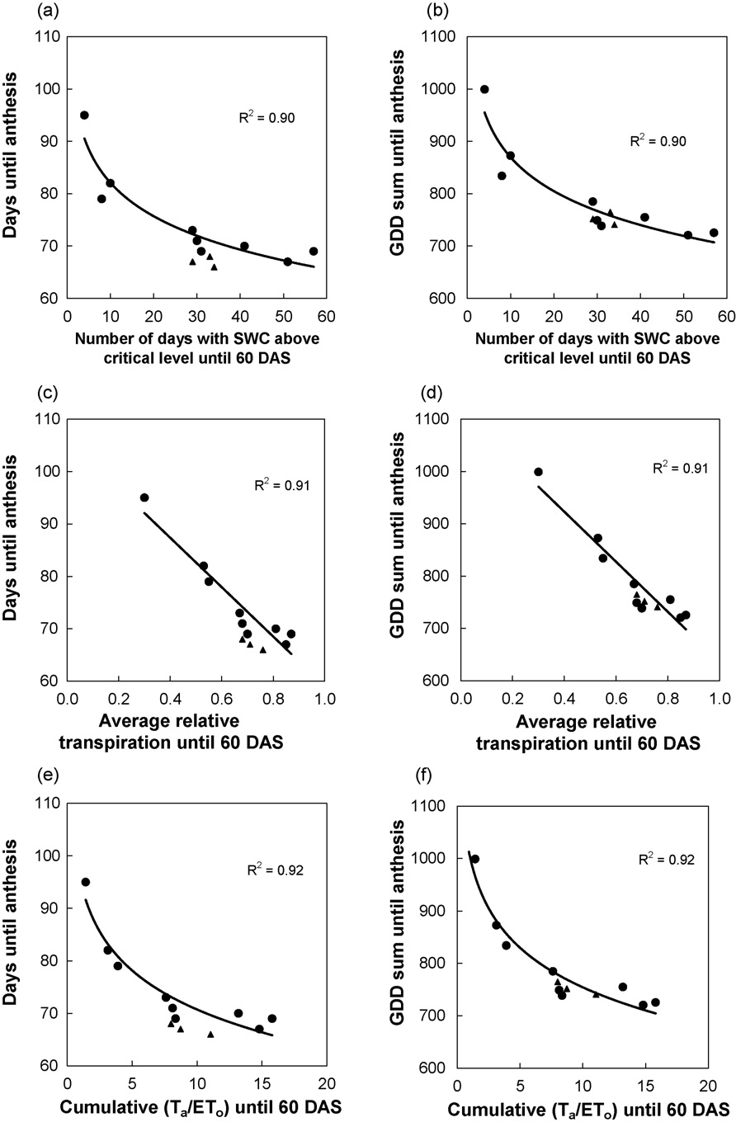
PHENOLOGY ADJUSTMENTS
IN RESPONSE TO DROUGTH

Slide 13
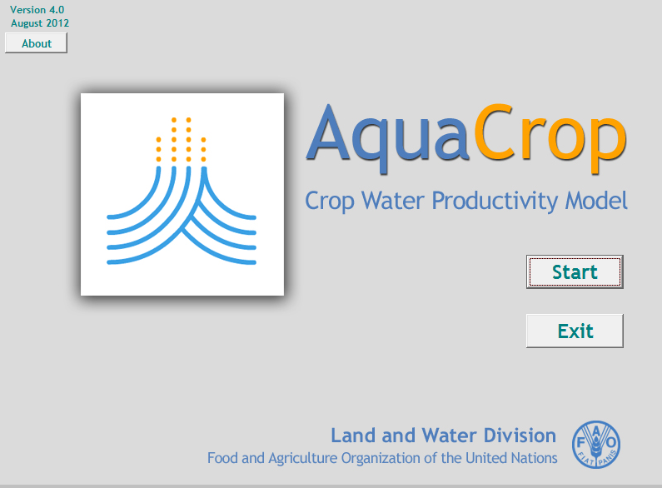
Modelling Deficit Irrigation impacts on yields, applying Aquacrop
http://www.fao.org/nr/water/aquacrop.html

Slide 14
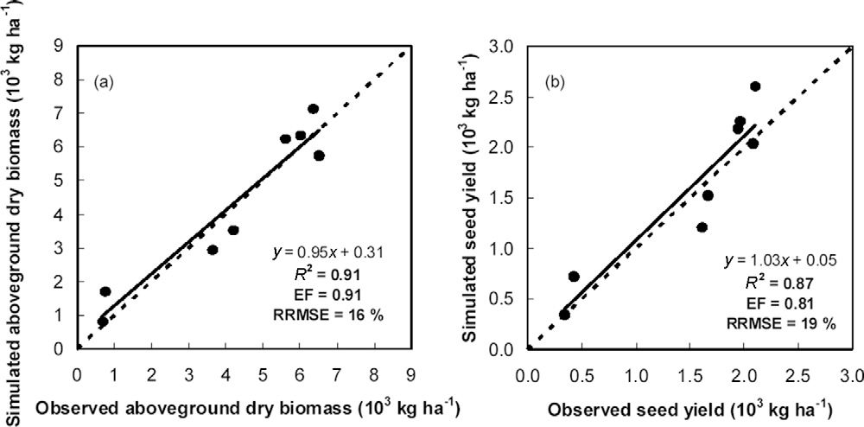
Modelling the adjustment in biomass and yields due to water stresss

Slide 15
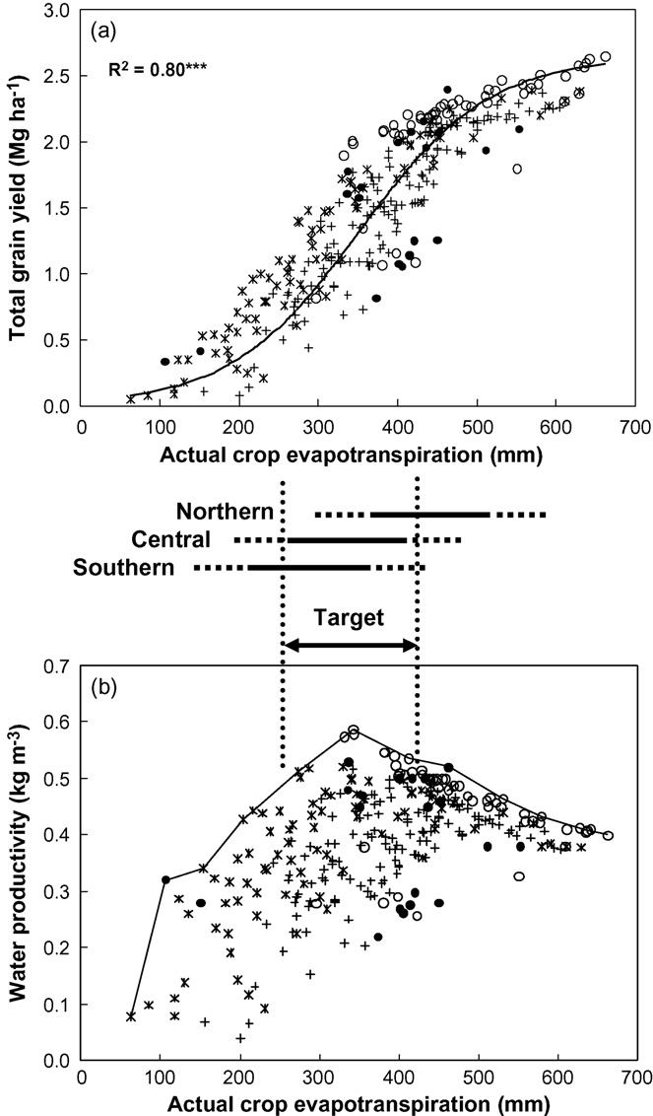
THE MODEL COULD ALSO BE USEFUL FOR ECONOMIC ANALYSIS OF
YIELDS AND BEST WATER USE EFFICIENCY RATES

Slide 16
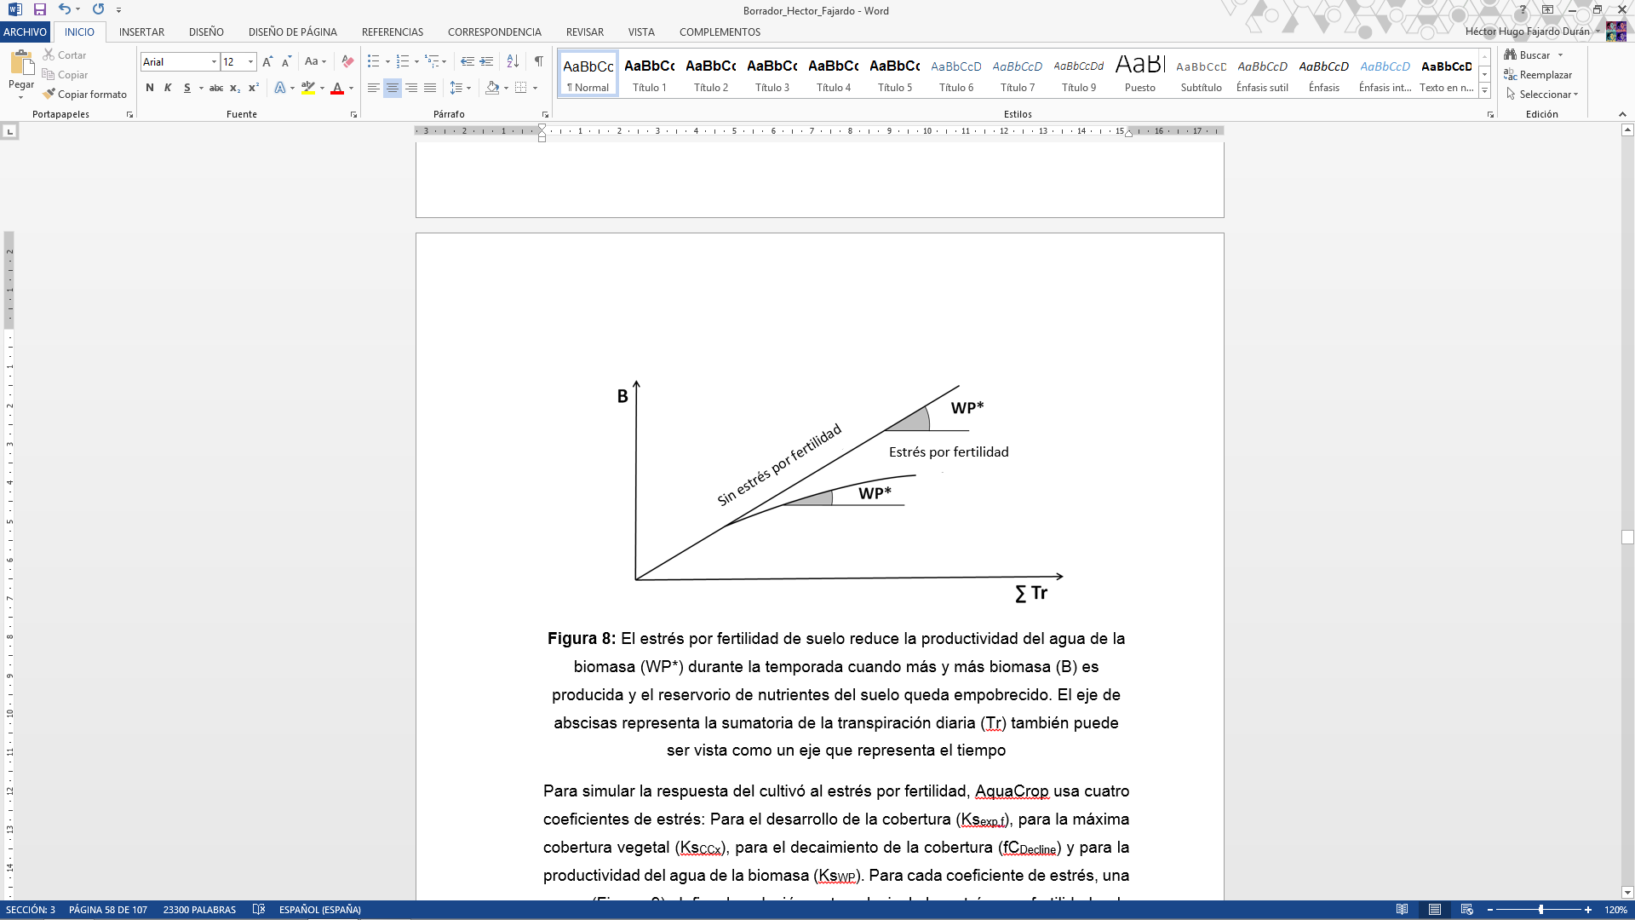
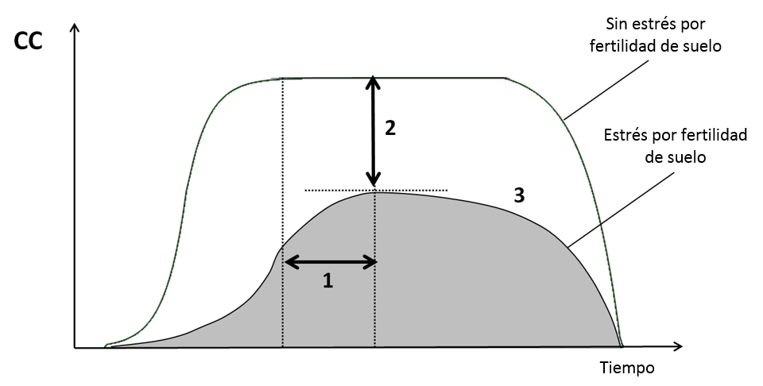
The model also reflects the adjustment in yields due to water stresss integrated to fertility stress

Slide 17
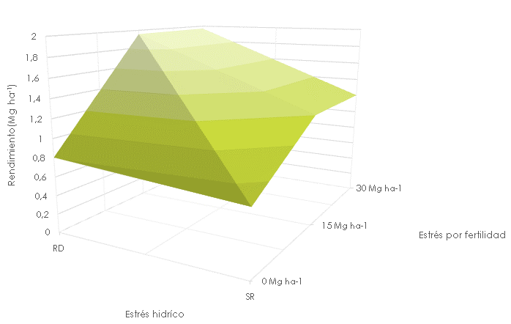
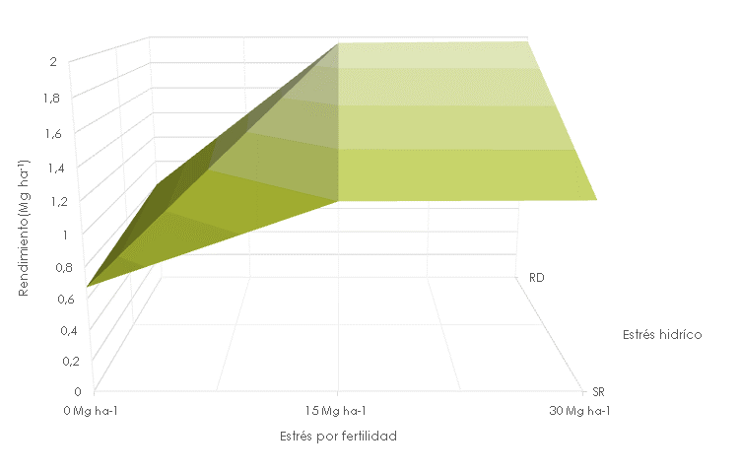
Relationship between soil fertility and soil water availability
Reduced soil nitrogen use efficiency under water stress (to be considered)

Slide 18
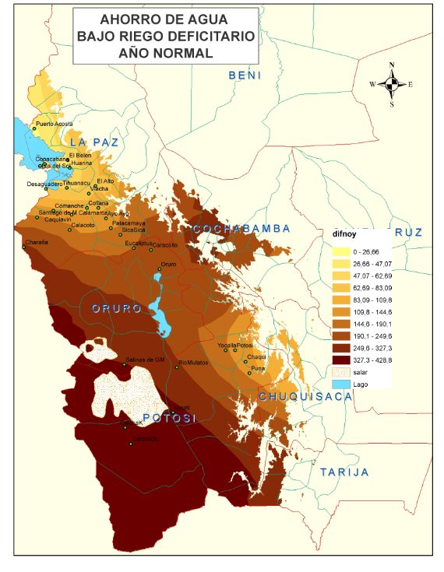
Water savings according to the locations

Slide 19
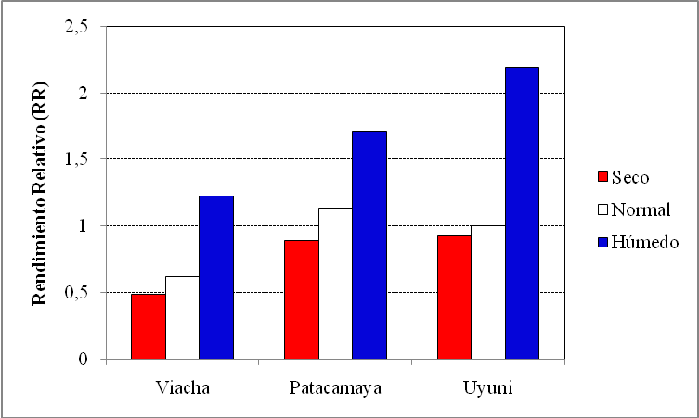
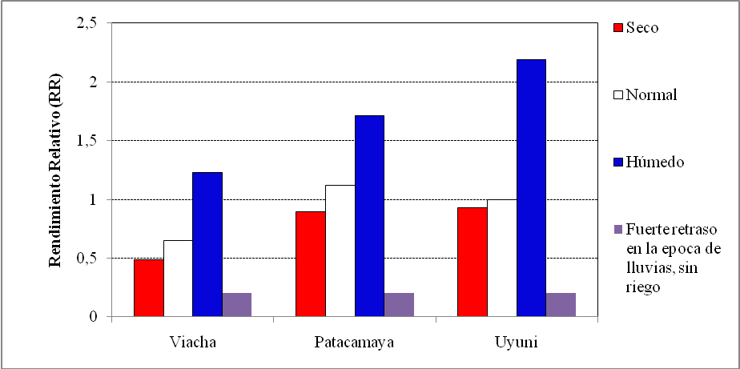
Estimated yields under Climate change conditions

Slide 20
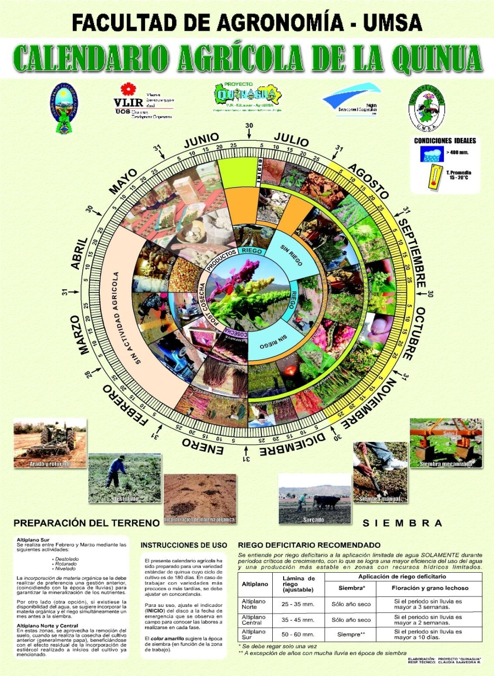
Tools for adequate cropping and (deficit) irrigation management

Slide 21
Lessons learnt
Technological innovations · deficit irrigation, mechanised raised bed farming and soil improvement techniques · increase production while using natural resources more efficiently in the Highlands, (as much as in other part of the world), but could enhance much more the locally positive impacts of climate change (reduced frost risk).
There is a growing trend to model the likely impacts of climate change on crops with (also) modeled data for the future. However, if the model is not properly calibrated, the results might lead to strong policy mistakes, especially for locally prevalent or endemic crops.
It is extremely important to evaluate the combined impacts of fertility and water availability improvements, especially in poor fertility production areas, because water addition under poor soil fertility conditions could only discourage farmers to invest in (deficit) irrigation facilities, since the obtained yields are likely to be low.
Governance, effective water users associations are needed to compensate for reduced state involvement in water management at local level; members of water users associations need to feel ownership of their associations for sustainability (several problems with temporal migration in the quinoa production area).
It is extremely important to understand the need to organise and prepare farmers for market variations, because higher yields could lead to collapsing prices and all investments would be useless, discouraging farmers to invest in WUE facilities.

Slide 22
THANK YOU

