Slide 1
The valuable science in the local climate knowledge in the high Andean farming systems. (Second phase)
Valuing local resources
Magalí Garcia, Jere Gilles, Edwin Yucra

Slide 2
Objetive :
Technological and advanced Validation of local high andean farmers knowledge and development of an early warning system for long and short term actions.

Slide 3
Bases Teóricas:
The IPCC strongly advices that early warning or adaptation actions must be integrated to the IK, especially in strongly heterogeneous areas.
Andean farming since more than 3000 years ago has sustained agriculture under a very difficult farming area using different strategies (large agrobiodiversity, strong observation of the ecosystem, well known atmospheric situation with some advances toward forecast).
Although several trials for early warning systems have been proposed and even developed, most are not used or have problems of application partly due to the very heterogeneous ecosystems which do not respond similarly to similar conditions or does not receive similar effects.
There is some limited work demonstrating that Indigenous Knowledge in the High Andes has strong atmospheric basis that could be related to long term atmospheric teleconnections and that has not been deeply explored.

Slide 4
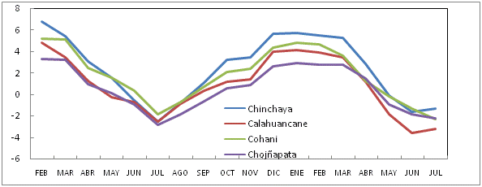
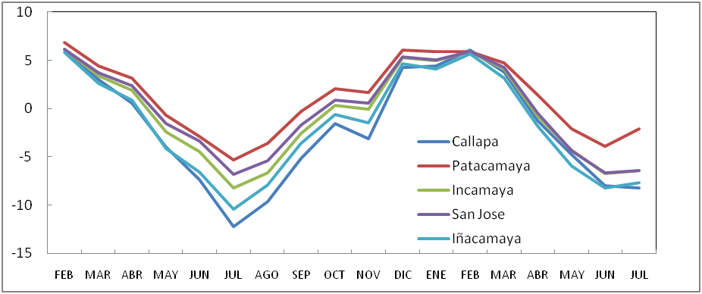
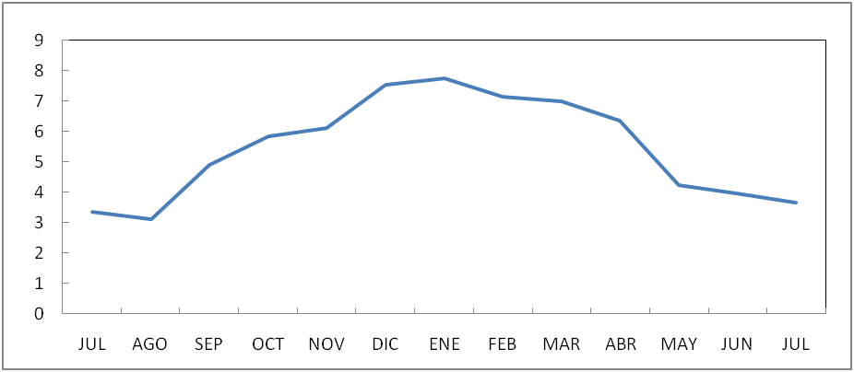
Strong local heterogeneity. For example: Tmin
General actions or even Municipal actions are likely not accepted or followed by farmers.

Slide 5
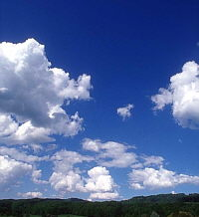
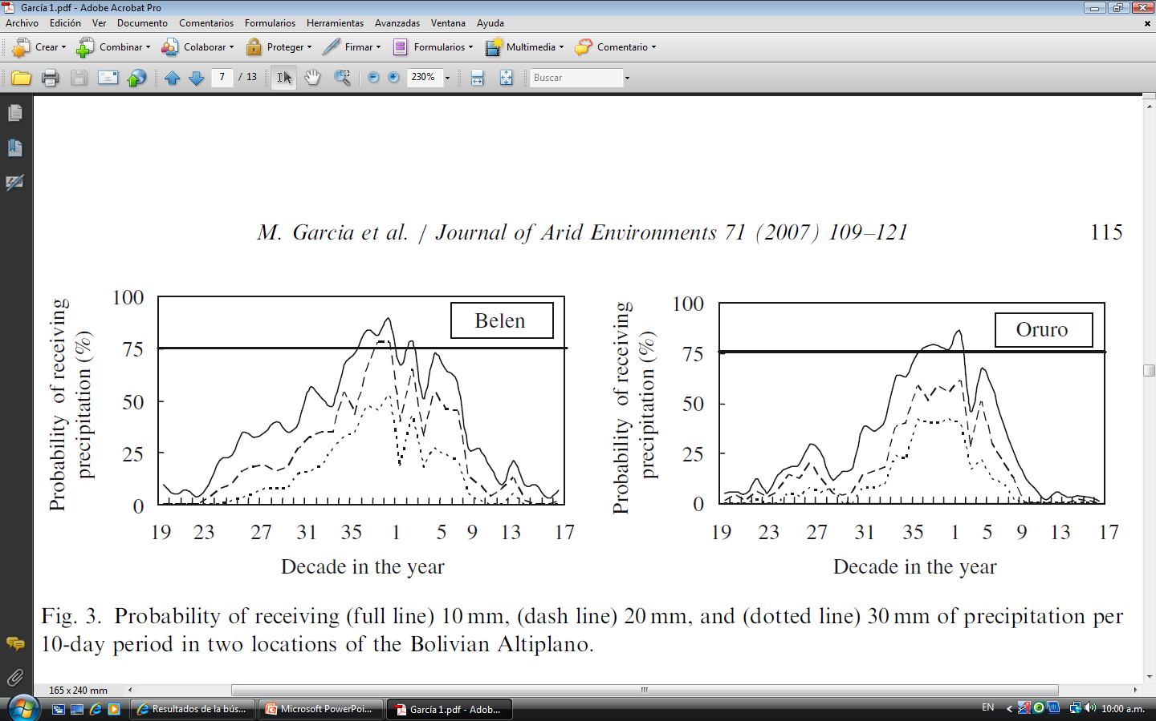
General statistical analysis showed strong certainty in farmers observations.

Slide 6
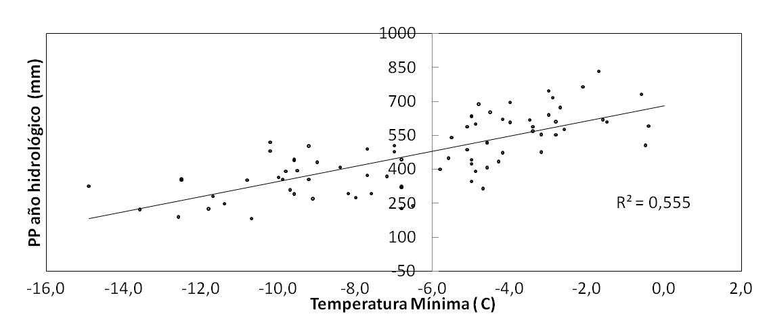
What we found: Validity of local indicators
Correlation of some local indicators with the behavior of next rainy season
Relación Tmin y precipitación recibida en el siguiente año hidrológico en 3 observatorios meteorológicos del Altiplano Central y del Altiplano Norte de Bolivia

Slide 7
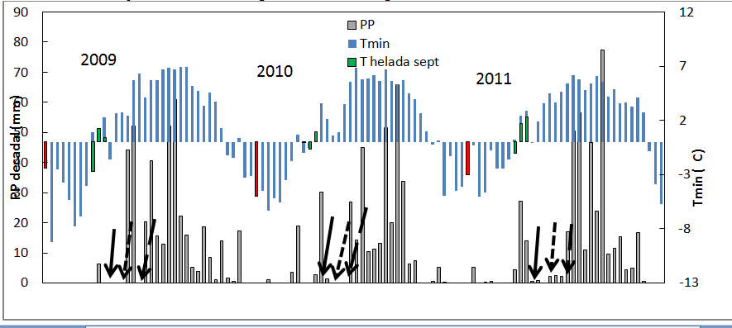
Correlation of frost and failure of flowering with sowing time

Slide 8
Could it be a type of teleconnections?
Esquema propuesto por Orlove et al. (2002) para explicar la reducida visibilidad de las Pleyades en el Este de los Andes. Obsérvese la reducida nubosidad que arriba al Altiplano

Slide 9
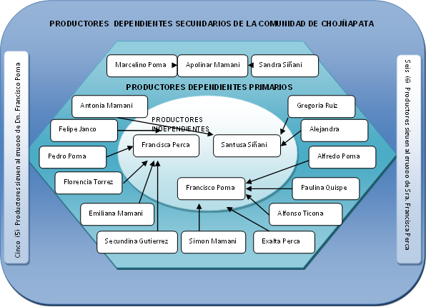
Transmission of this knowledge is not formal and is part of a local network
PRODUCTORES DEPENDIENTES SECUNDARIOS DE LA COMUNIDAD DE CHOJÑAPATA
Cinco (5) Productores siguen al gruopo de Dn. Francisco Poma
PRODUCTORES DEPENDIENTES PRIMARIOS
Marcelino Poma
Apolinar Mamani
Sandra Siñani
Seis (6) Productores siguen al gruopo de Sra. Francisca Perca Pomaerca
Antonia Mamani
PRODUCTORES INDEPENDIENTES
Gregoria Ruiz
Felipe Janco
Alejandra Luque
Francisca Perca
Santusa Siñani
Pedro Poma
Alfredo Poma
Florencia Torrez
Francisco Poma
Paulina Quispe
Emiliana Mamani
Alfonso Ticona
Secundina Gutierrez
Simon Mamani
Exalta Perca

Slide 10
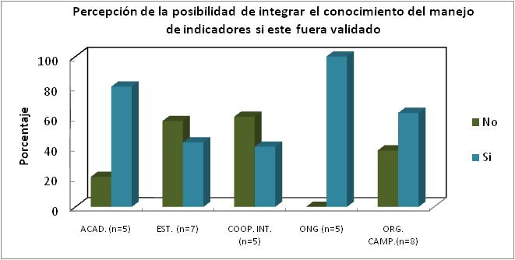
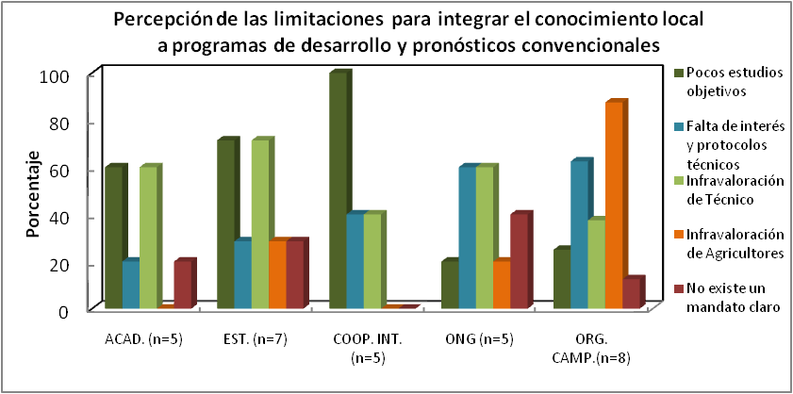
PERCEPTIONS ABOUT THE POTENTIALITIES AND LIMITATIONS TO INTEGRATE THE KNOWLEDGE WITHIN DEVELOPMENT PROGRAMS
Notes:
Aquí mostraremos la diferencia en percepción sobre el riesgo de pérdida del conocimiento y sus causas

Slide 11
SUMMARIZED METHODOLOGY
Establishment of a geographically well distributed network of highly trained “observers” (farmers) who would be in charge of reporting the observed events.
Integration with Remote sensing techniques which will collect a historical library of imagery and will try to develop an analysis of the mechanisms that develop the observations done by farmers.
Meteorological Analysis of the farmers´ observed events integrated to national and international observatories for regional early warning and forecast.
Distribution and diffusion of the obtained information both at local and national levels according to what is pertaining.

Slide 12
THANK YOU

