Slide 1

Networks to advance
climate services
An example of the CSP
Cathy Vaughan
cvaughan@iri.columbia.edu

Slide 2

Why are networks important to climate services?
Climate services are inherently networked activities
  need to foster connections between range of relevant actors
Share lessons learned
Join forces & share resources
Coordinate overlapping activities

Slide 3

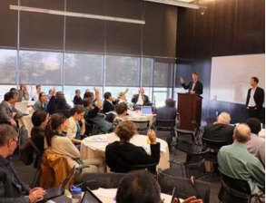
Climate Services Partnership
Informal, interdisciplinary network of climate information users, providers, donors, researchers, etc.
Founded in 2011
2000+ members around the world

Slide 4
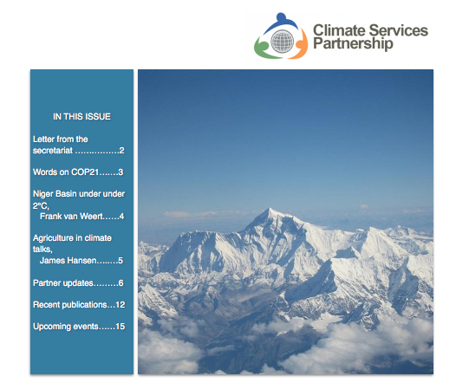
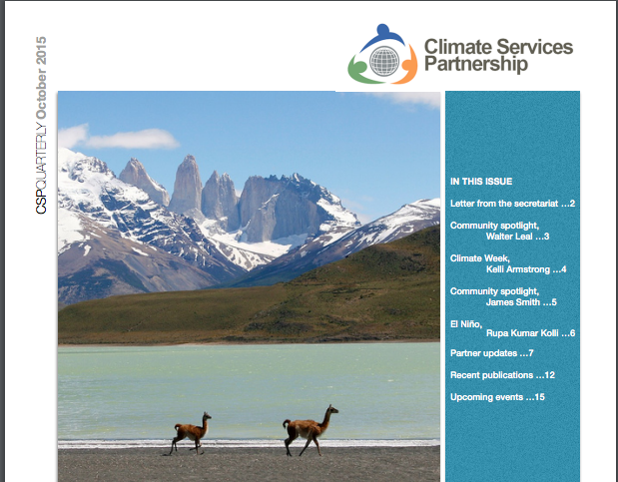
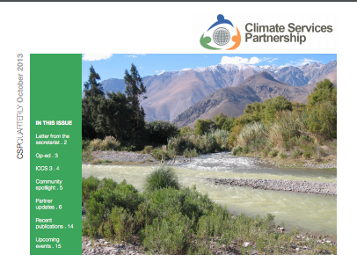

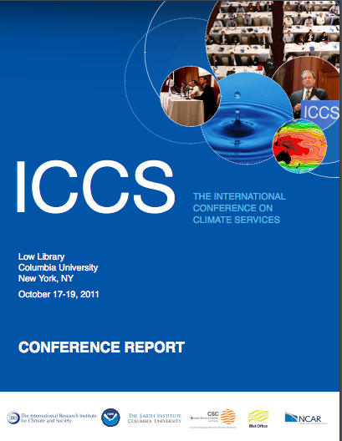

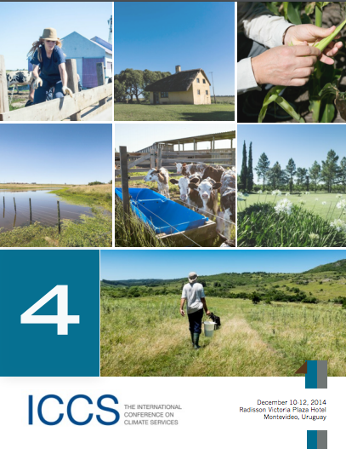
CSP: Fostering connections
Newsletters
Early career professionals networks
International Conference on Climate Services

Slide 5
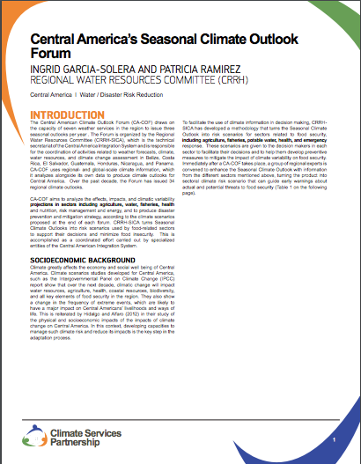
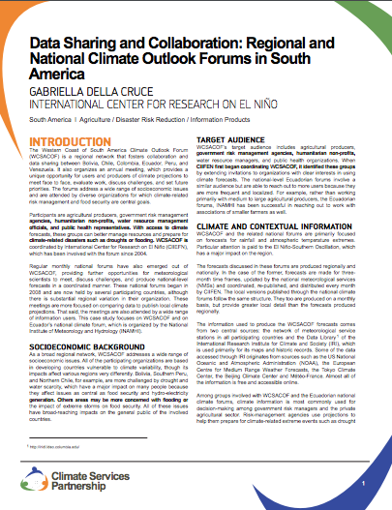
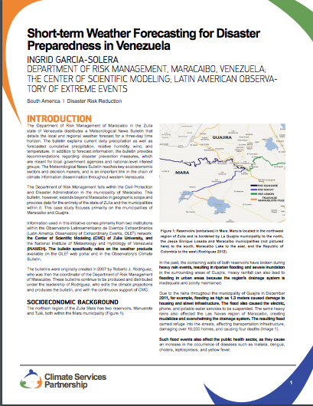
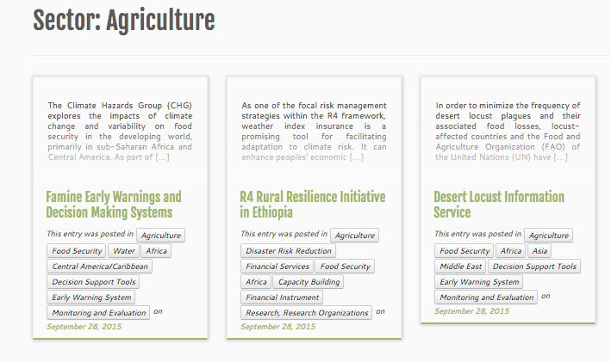
CSP: Sharing knowledge
Webinars
Case studies, synthesis
  Ethics

Slide 6
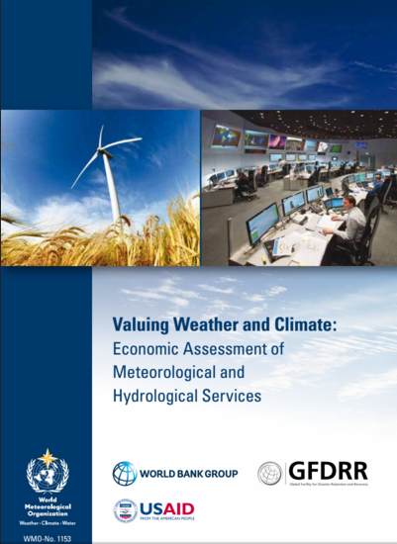
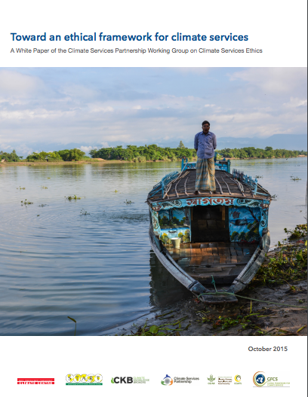
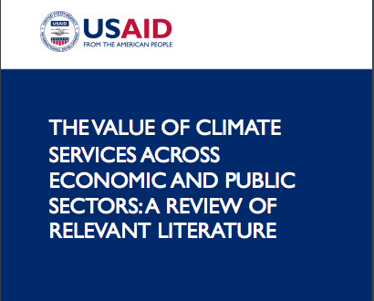
CSP: Generating knowledge
Climate Service Ethics
Economic Valuation
Evaluation

Slide 7
CSP: Contacts & upcoming activities
April Humble
Climate Services Center Germany
http://www.climate-services.org/
International Conference on Climate Services – 5
Cape Town – November 2016 (?)

Slide 8

ClimatEurope
Led by UK Met, includes BCSC, Climate KIC, SMHI, KMNI, ECMWF, etc.
Objectives include:
  Develop a Europe-wide framework for Earth-system modeling & climate service activities
  Coordinate & integrate on-going & future European climate modeling, climate observations & climate service infrastructure initiatives
  Establish multi-disciplinary expert groups to assess the state-of-the-art, identify existing gaps, new challenges & emerging needs
  Enhance communication & dissemination activities with stakeholders

Slide 9
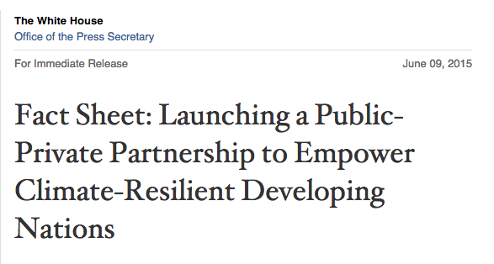
Climate Services for Resilient Development
Led by USAID, leveraging NOAA, NASA, and other U.S. agencies; includes DfID, UK Met, Inter-American Development Bank, Asian Development Bank, Esri, Google, American Red Cross, Skoll Global Threats Fund
Objective: Seeks to develop new tools, services, and approaches that bridge technology and organizational gaps in order to strengthen climate resilience
Initial focus on three countries: Colombia, Ethiopia, and Bangladesh

Slide 10
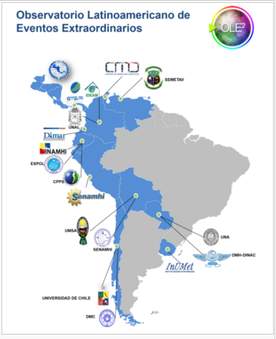
Latin American Observatory on Extraordinary Events
Informal network of NMHS, research institutes, health ministries, etc.
Founded in 2008
Focuses on the monitoring of environmental variables, improving technical skills and the provision of scientific-tools for decision making, early warning and risk management
Share data, methodologies, analysis, shared wiki, etc.

Slide 11
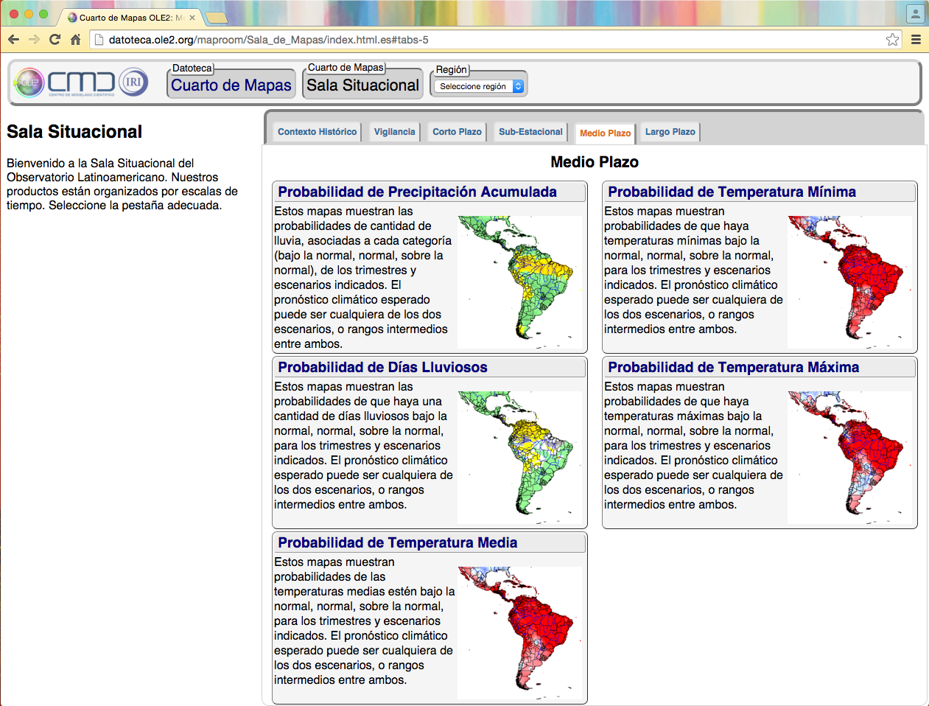
OLE Datoteca
Products at multiple timescales -- historical, monitoring, 7-day forecast, sub-seasonal (MJO) & seasonal forecast (5 variables)
Probabilistic cross-validated seasonal forecasts (2000-2016), freely available online. Created with IRI’s CPT.
Datoteca is local version of IRIDL
http://datoteca.ole2.org

