Slide 1
Inter-university Programme in Water Resources Engineering
Prof. Willy Bauwens & Guido Wyseure
24 February, 2016

Slide 2
Inter-university Programme
KU Leuven
Fac. Bio-engineering
Fac. Engineering
Fac. Sciences
Vrije Universiteit Brussel
Fac. Engineering
Fac. Sciences
+
Inter-faculty

Slide 3
Academic dpt.’s & staff
Fac. Bioscience Engineering
Div. Soil & Water Management
Diels J.
Wyseure G.
(De Lannoy G.)
Fac. Science
Chemistry Dpt.
Elskens M.
Fac. Engineering
Dpt. Hydrology & Hydraulic Eng.
Bauwens W.
Huysmans M.
Quevauviller Ph.
Van Griensven A.
Willems P.
Fac. Engineering
Civil Engineering
Hydraulics section
Monbaliu J.
Toorman E.
Willems P.
Fac. Engineering
Chemical & Biochem. Process Techn. & Control Sect.
Smets I.
(Vanderbruggen B.)
Fac. Sciences
Biology Dpt.
Brendonck L.
De Meester L.
(Volckaert F.)

Slide 4
General philosophy of our MSc programme
Modelling approach is a cornerstone in our MSc programme
Most second year courses are modelling courses
First year gives the scientific basis for modelling
Inspired by modern integrated water management principles and the Water Framework Directive (2000/60/EC)
Integrated project at the Catchment scale

Slide 5
Program
http://onderwijsaanbod.kuleuven.be/opleidingen/e/SC_51016980.htm
Two years (phases) of 60 ECTS each
48
12
10
15
5
30
Year 1
Year 2

Slide 6
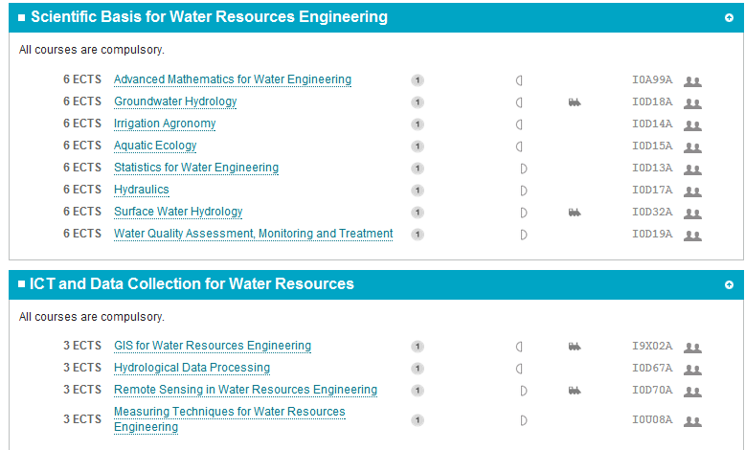
Year 1

Slide 7
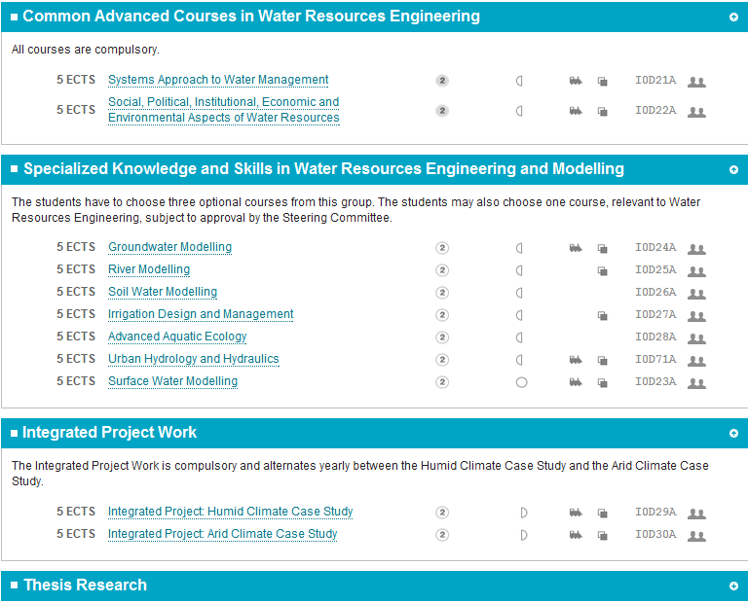
Year 2

Slide 8
Cooperation with Latin America
Students: 96 graduates in LA with Bolivia (39) and Ecuador (21) as most important countries
Diverse cooperation (mainly VLIR) projects in water resources and irrigation since the mid 90’s with:
Universidad (Estatal) de Cuenca, Ecuador
Universidad Mayor San Simon, Cochabamba, Bolivia
Universidad Mayor San Andres, La Paz, Bolivia
Universidad Nacional Agraria La Molina, Lima, Peru
Universidad Nacional Cajamarca, Peru
… some new cooperations coming up
Major changes in the university landscape in EC, PE and BO:
Previously teaching institutions lectures by part-time professionals
Now to universities with researcher-professors with PhD’s
New postgraduate MSc and PhD programmes
Quality control: private diploma selling institutes versus public universities with better standards

Slide 9
Cooperation with MSc in “recursos hidricos”
Interuniversity VLIR network in Ecuador: Universidad de Cuenca, Escuela politecnica nacional (Quito), ESPOL (Guayaquil) and UTN (Ibarra)
Integrated project as an integrating cornerstone course in the curriculum:
"Cuenca del Rio Jubones" in the South of Ecuador with a central area which is arid.
Applying the modelling to a catchment trying to study different aspects of the integrated water resources management.

Slide 10
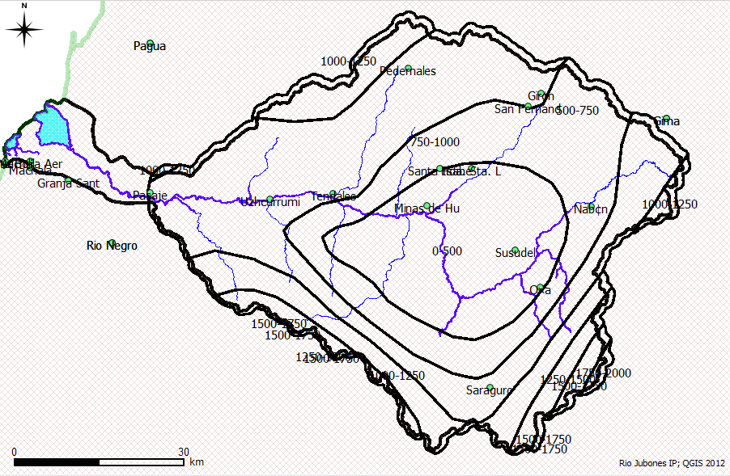
Rio Jubones; integrated project: Special Rainfall pattern
Coastal
zone
1000 mm
750 mm
500 mm
200 mm
350 mm
Amazon

Slide 11
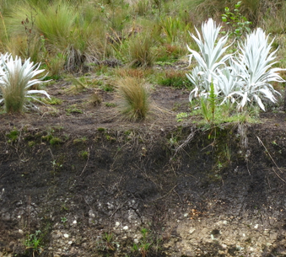
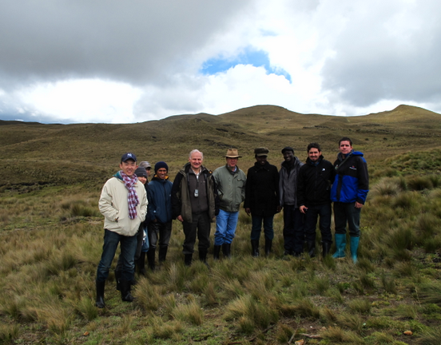
Paramo: ecosystem
Volcanic soil
> 3500 m; no or little trees
Colder (~Δ 1°C / 200 m)
More rain + mist
High water retention=> wetland properties
Water source for lower areas
3650 m

Slide 12
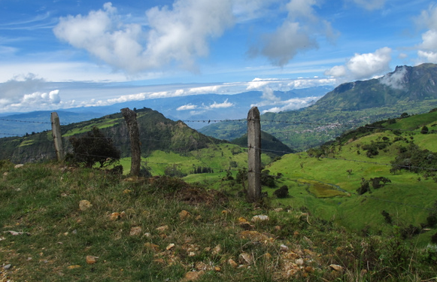
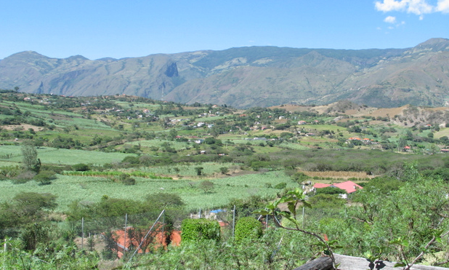
Topography
Pasture; Potato
3700 m (Quimsacocha)
Maize
2300 m (Susudel)
Sugar cane;
Citrus etc…
1500 m (Yunguilla valley)

Slide 13
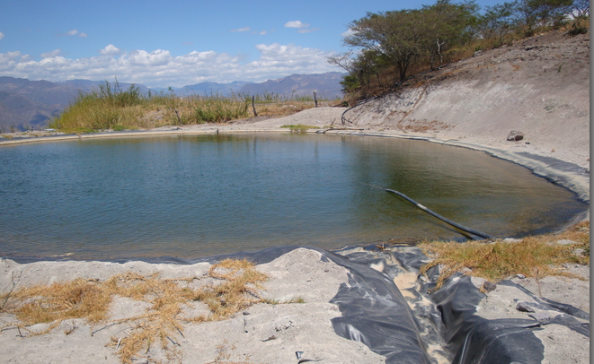
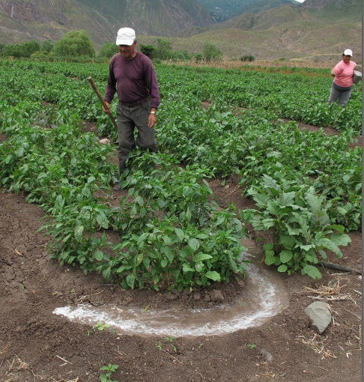
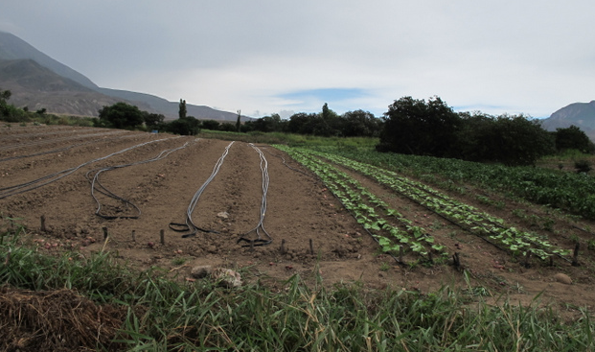
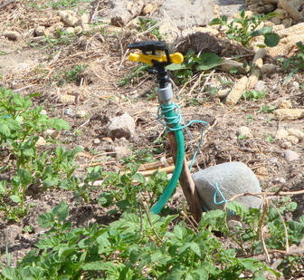
Irrigated Fields
Small farm reservoirs
(storage + pressurized systems)
(1000 m)
Drip
Surface irrigation by
blocked furrows
Sprinkler

Slide 14
Hydropower
Water in dam
790 m
270 m=> turbines

Slide 15
Conclusion: MSc Water Resources Engineering
Inter-university and -faculty programme pooling expertise from VUB and KU Leuven
Several projects in different continents in general, more in particular in Peru, Ecuador and Bolivia in Latin America
Training in "Water Resource Modelling" with applications in integrated water management with a project "Rio Jubones" dealing with issues like multiple purpose water use, climate and land use change…

